Slide 1
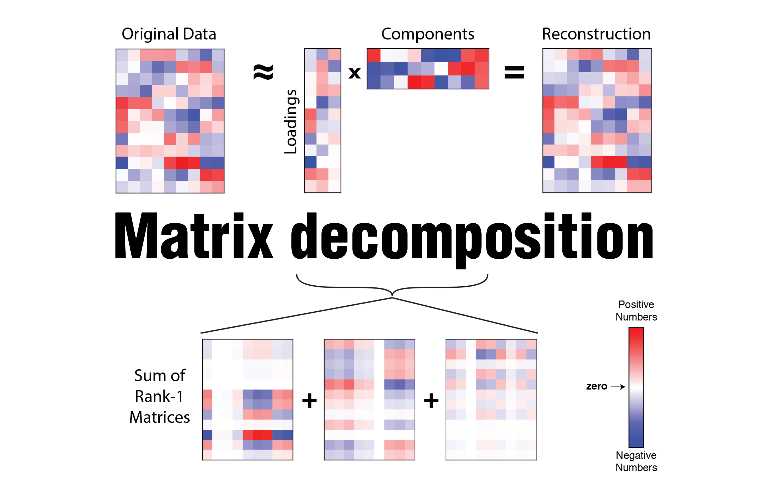

Slide 2



Neurosyntax Academy
@neurosyntaxacademy
@Neuro_Syntax
neurosyntax

Slide 3

I learned very early the difference between knowing the name of something and knowing something.
Richard Feynman

Slide 4
Session 1
Lecturer: Saman Abbaspoor

Slide 5

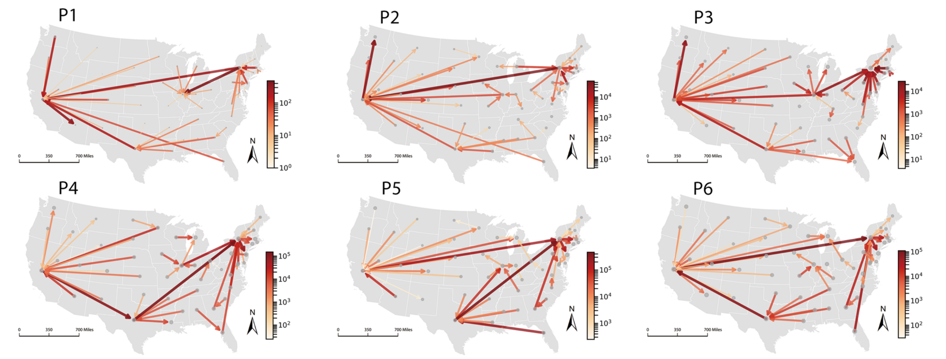
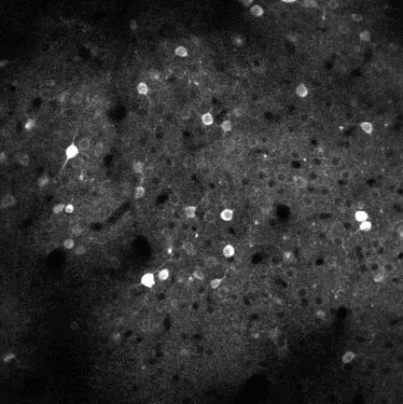
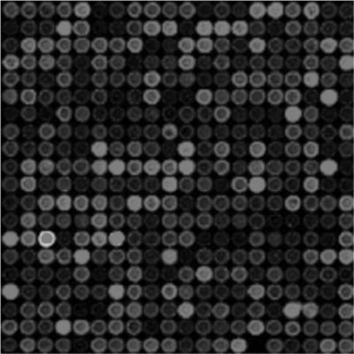
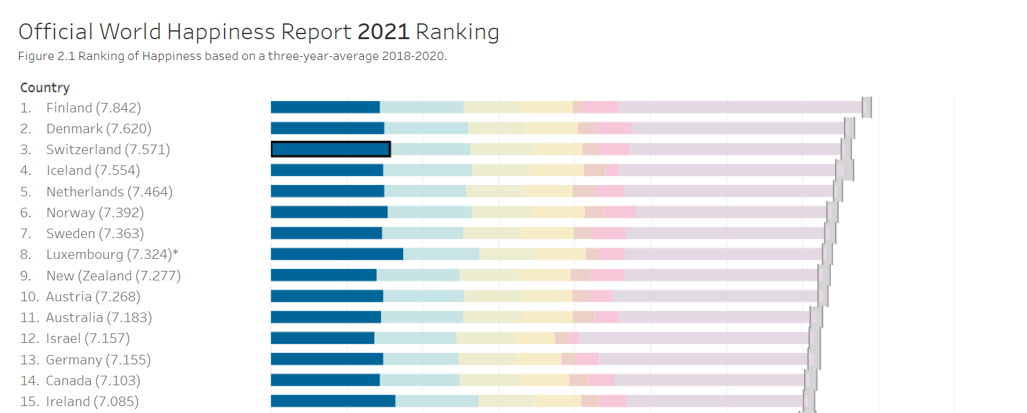
Discover patterns in nature and explain them

Slide 6
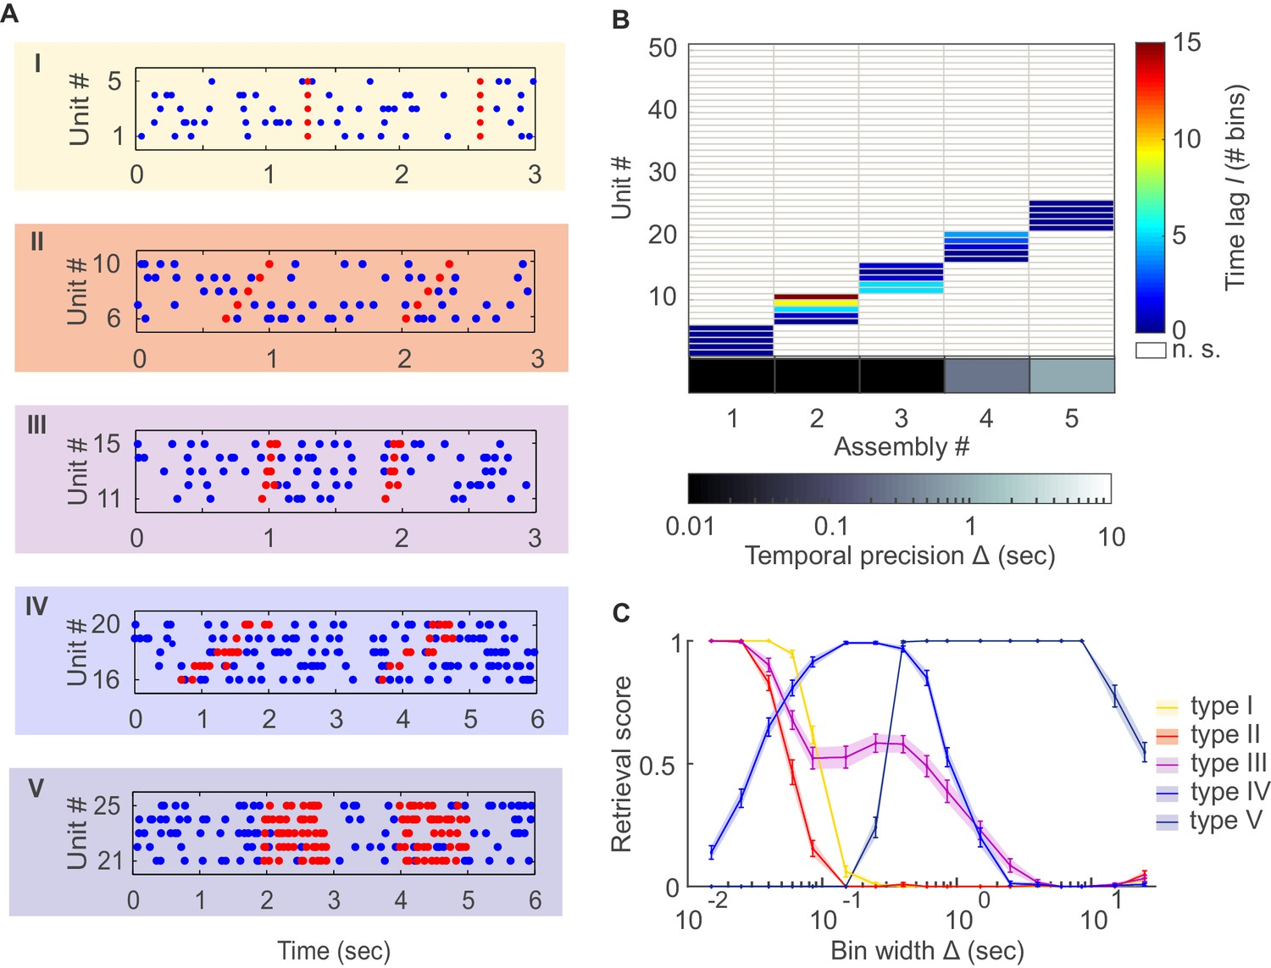
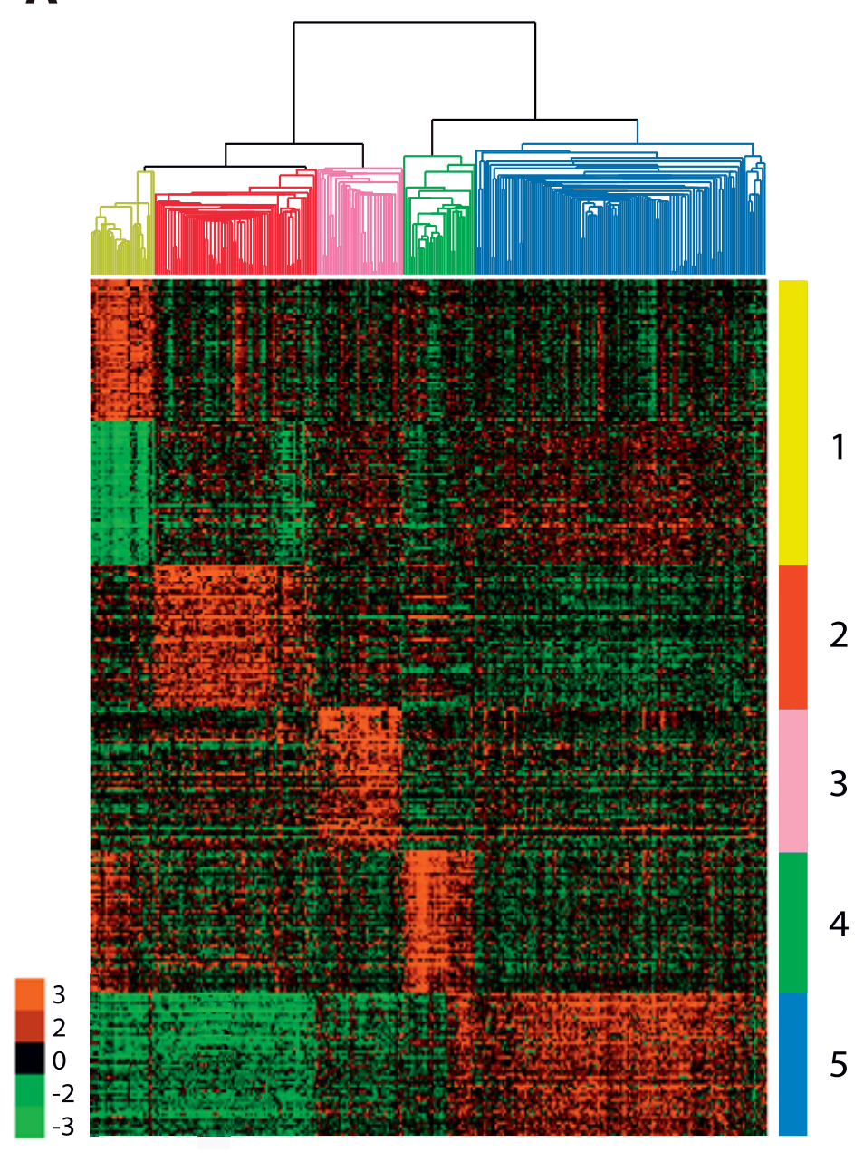
Patterns
Regularity and Predictability: patterns involve a predictable and repeatable arrangement of elements.
In terms of correlation, a pattern can be defined as a statistical relationship between two or more variables where changes in one variable are systematically associated with changes in another variable.
Gene expression

Slide 7
Observation and data structure
Matrix as a data structure
Column
Rows, Columns, and Values in a matrix are meaningful under the context of the data structure
Row
Value

Slide 8
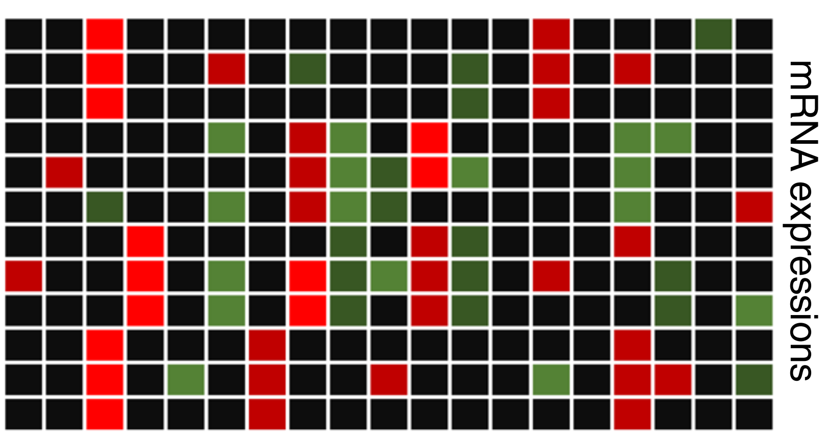
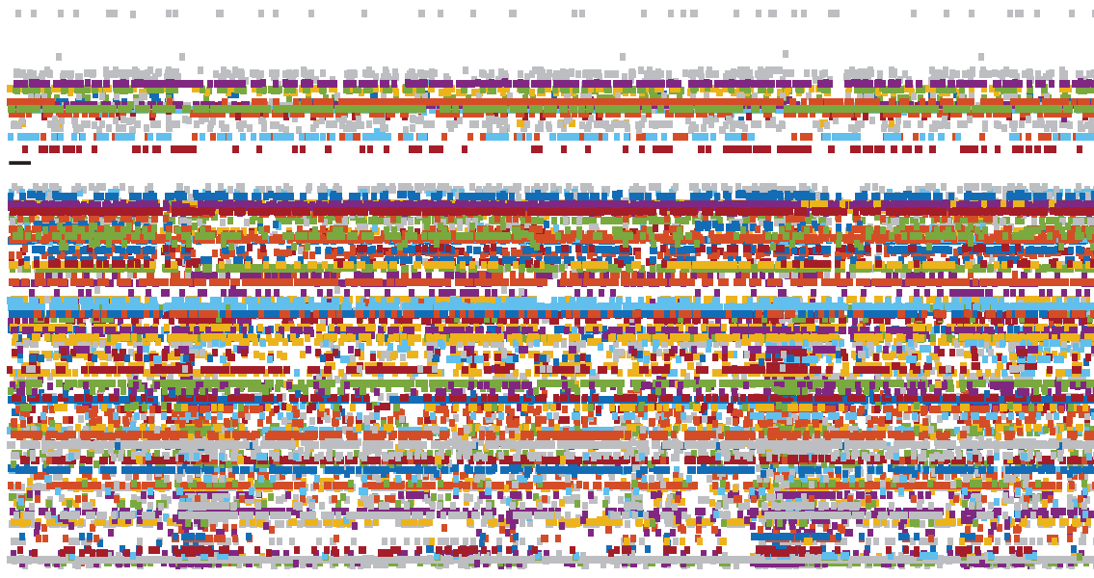
Observation and data structure
Matrix as a data structure
mRNA expression matrix
Spike Activity Matrix
Gene
Cell #
Treatment
Time

Slide 9
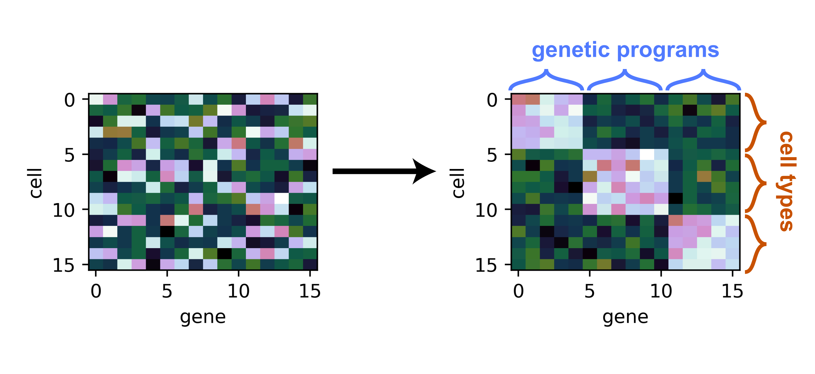
Discover patterns in high-throughput datasets
Dimensionality Reduction for Matrix- and Tensor-Coded Data [Part 1] – Alex Williams

Slide 10
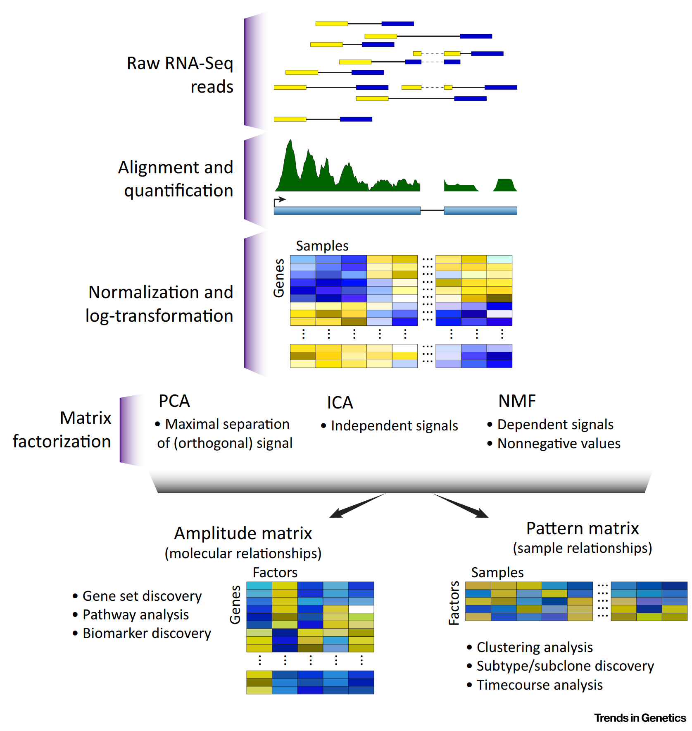
Enter the Matrix: Factorization Uncovers
Patterns
Stein-O’Brien et al., Trends in Genetics 2018

Slide 11
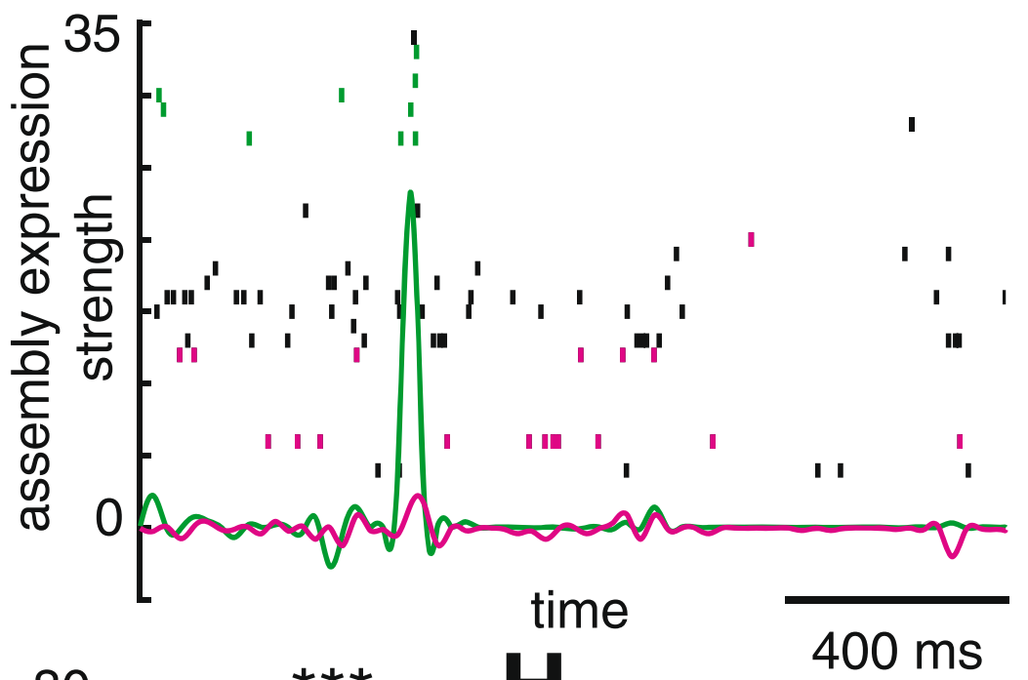
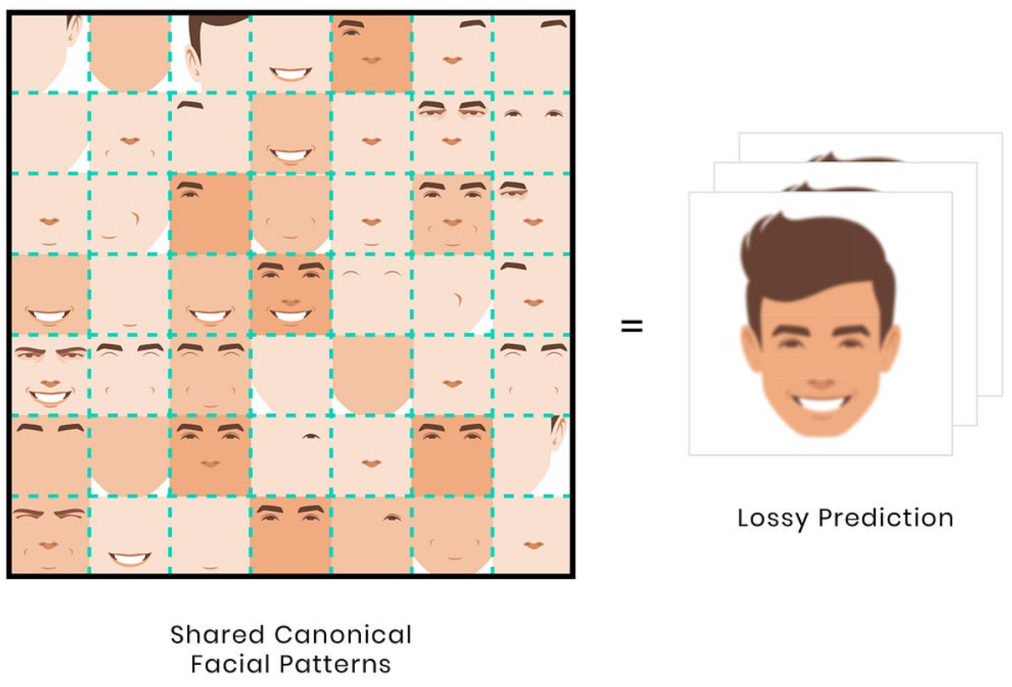

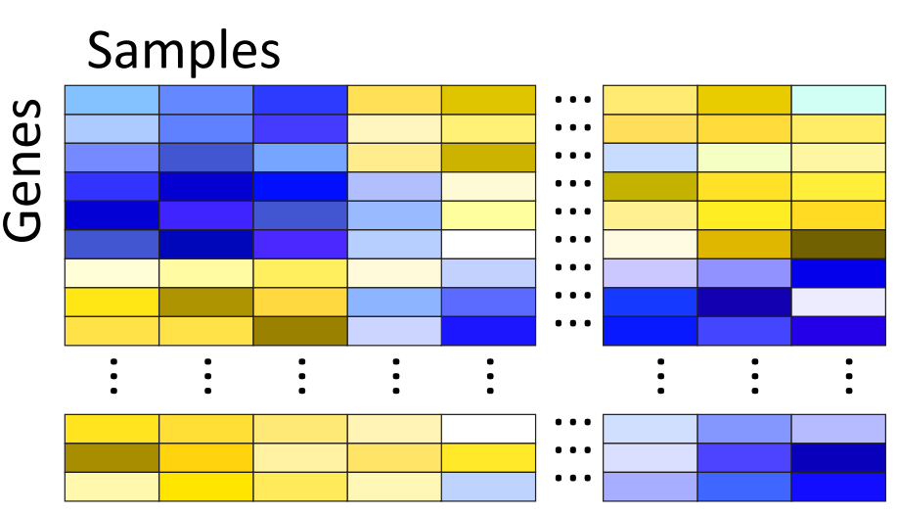

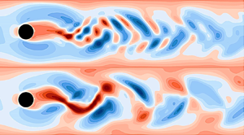
Applications of matrix decomposition
Neuroscience data
Image recognition
Search engines
Omics data
Fluid Dynamics

Slide 12
High-dimensional data spaces

Slide 13
Projecting high throughput data into high-dimensional spaces
Var 1
Var 2
Var
Var 3
Sample

Slide 14
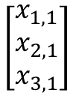
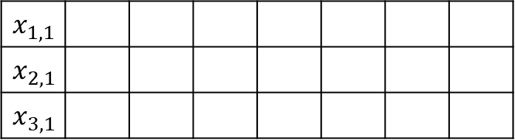
Projecting high throughput data into high-dimensional spaces
Var 3
$$\left[\begin{matrix}x_{1,1} \\ x_{2,1} \\ x_{3,1}\end{matrix}\right]$$
$$x_{1,1}$$
$$x_{2,1}$$
$$x_{3,1}$$
Var
Var 1
Sample
Var 2

Slide 15
Projecting high throughput data into high-dimensional spaces
Var 3
Var 1
Var N
Var 2

Slide 16
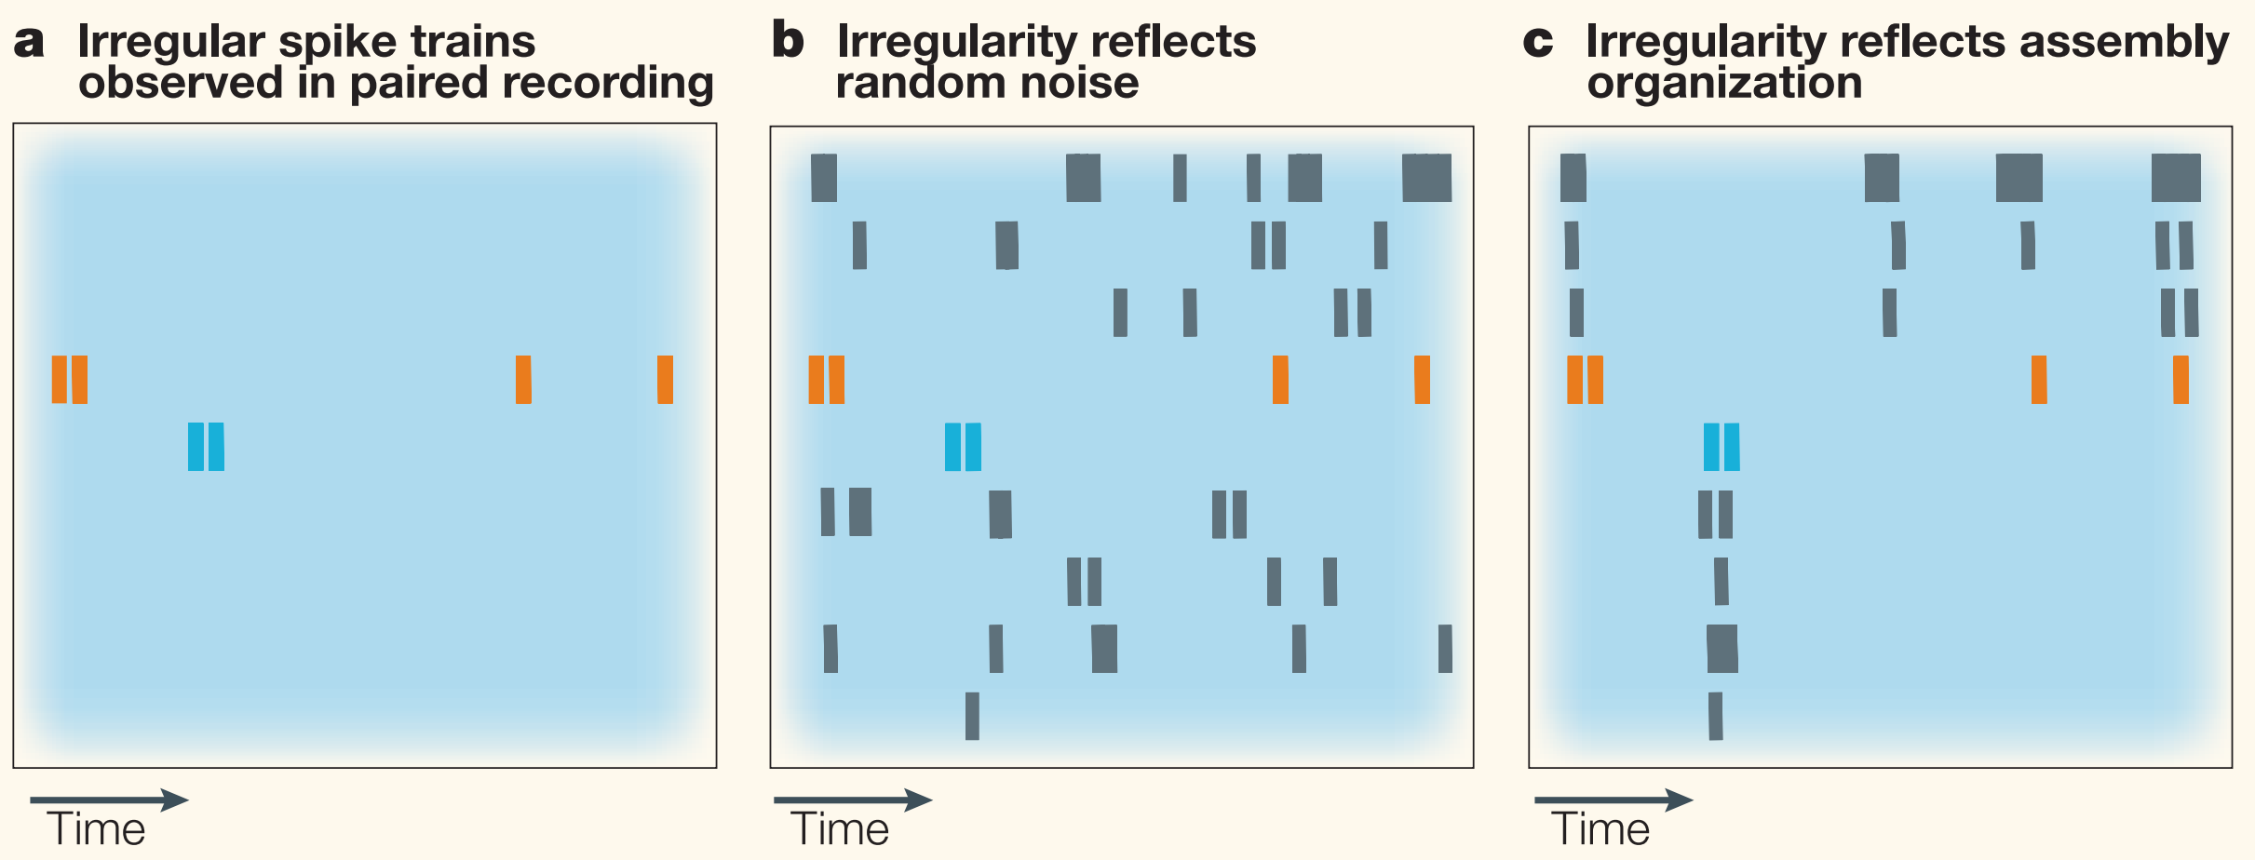
Higher dimensional data spaces might uncover patterns

Slide 17
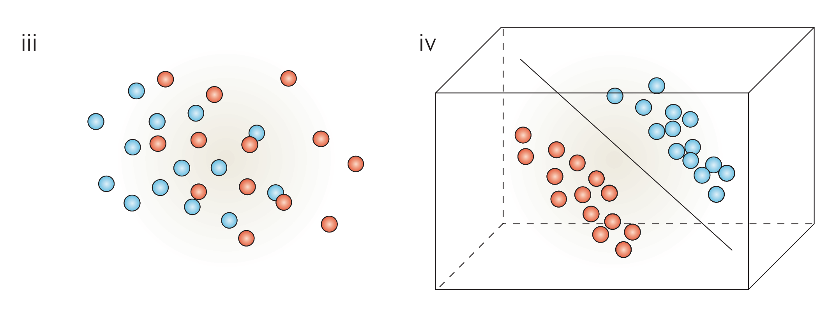
Cluster separability in data space
The properties of high-dimensional data spaces, Clarke et al., Nature Reviews Cancer

Slide 18
Vector

Slide 19
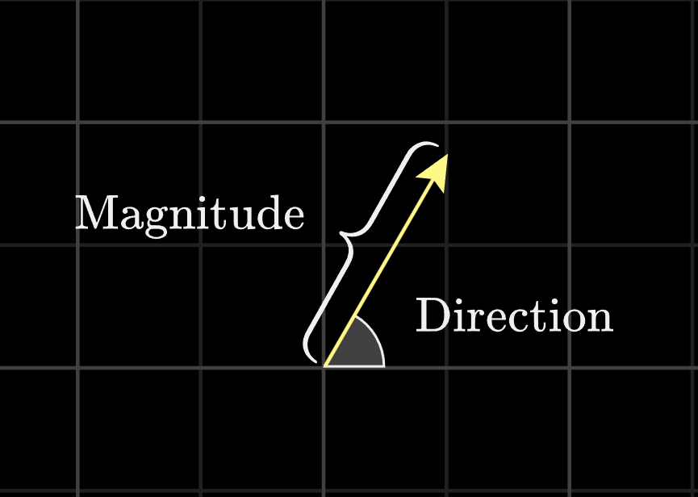
Vectors
A quantity that has magnitude as well as direction is called a vector. The point A from where the vector starts is called its initial point, and the point B where it ends is called its terminal point. The distance between initial and terminal points of a vector is called the magnitude (or length) of the vector.

Slide 20
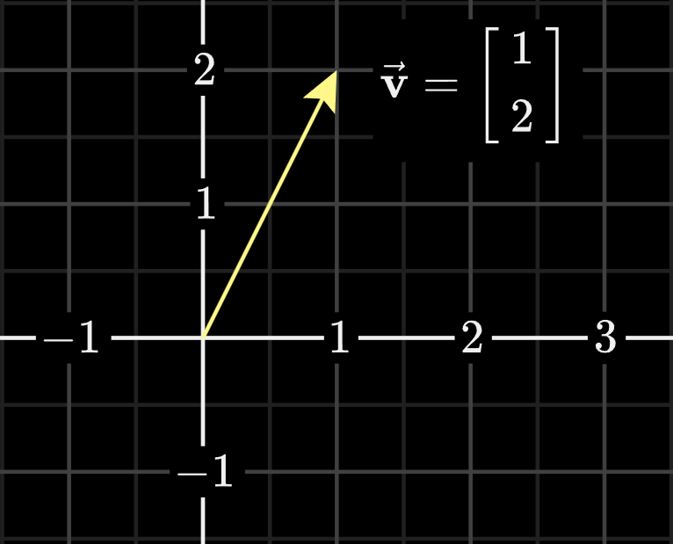
Vectors
A quantity that has magnitude as well as direction is called a vector. The point A from where the vector starts is called its initial point, and the point B where it ends is called its terminal point. The distance between initial and terminal points of a vector is called the magnitude (or length) of the vector.
https://www.3blue1brown.com/lessons/vectors

Slide 21
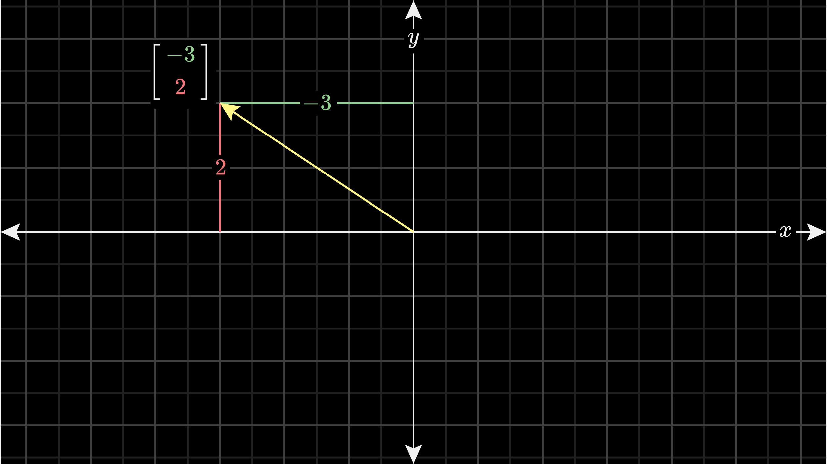
Thinking About Coordinate Systems
Origin

Slide 22
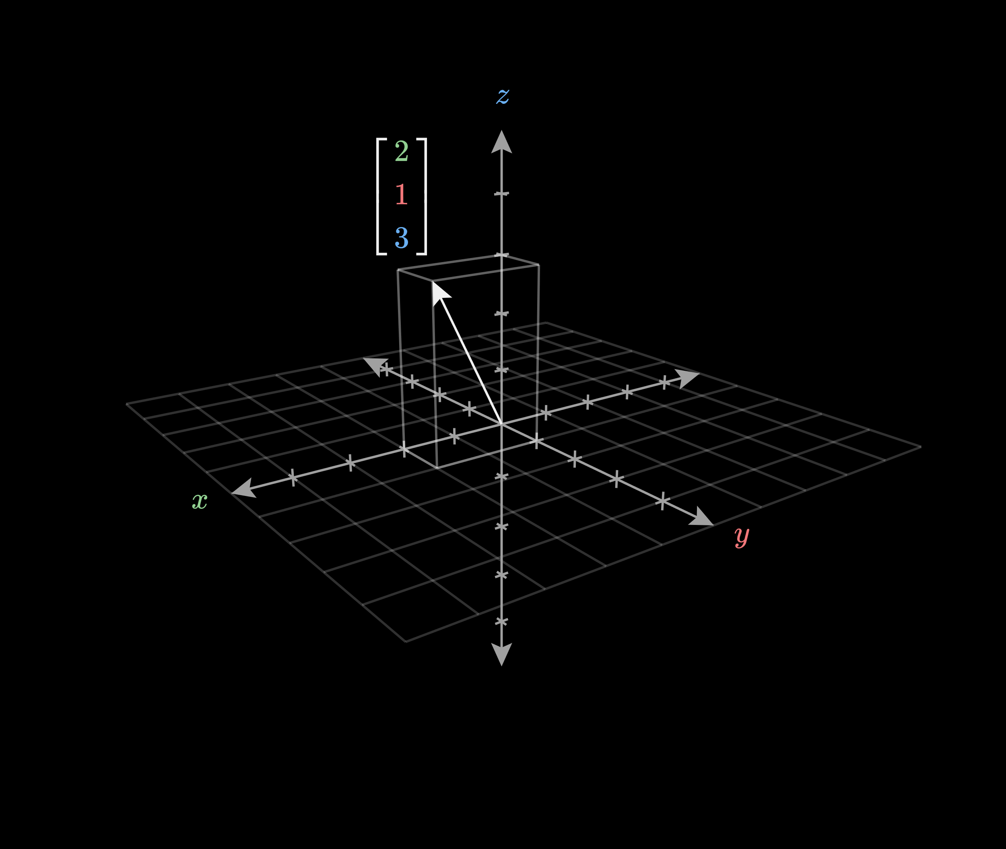
3D Coordinate Systems

Slide 23
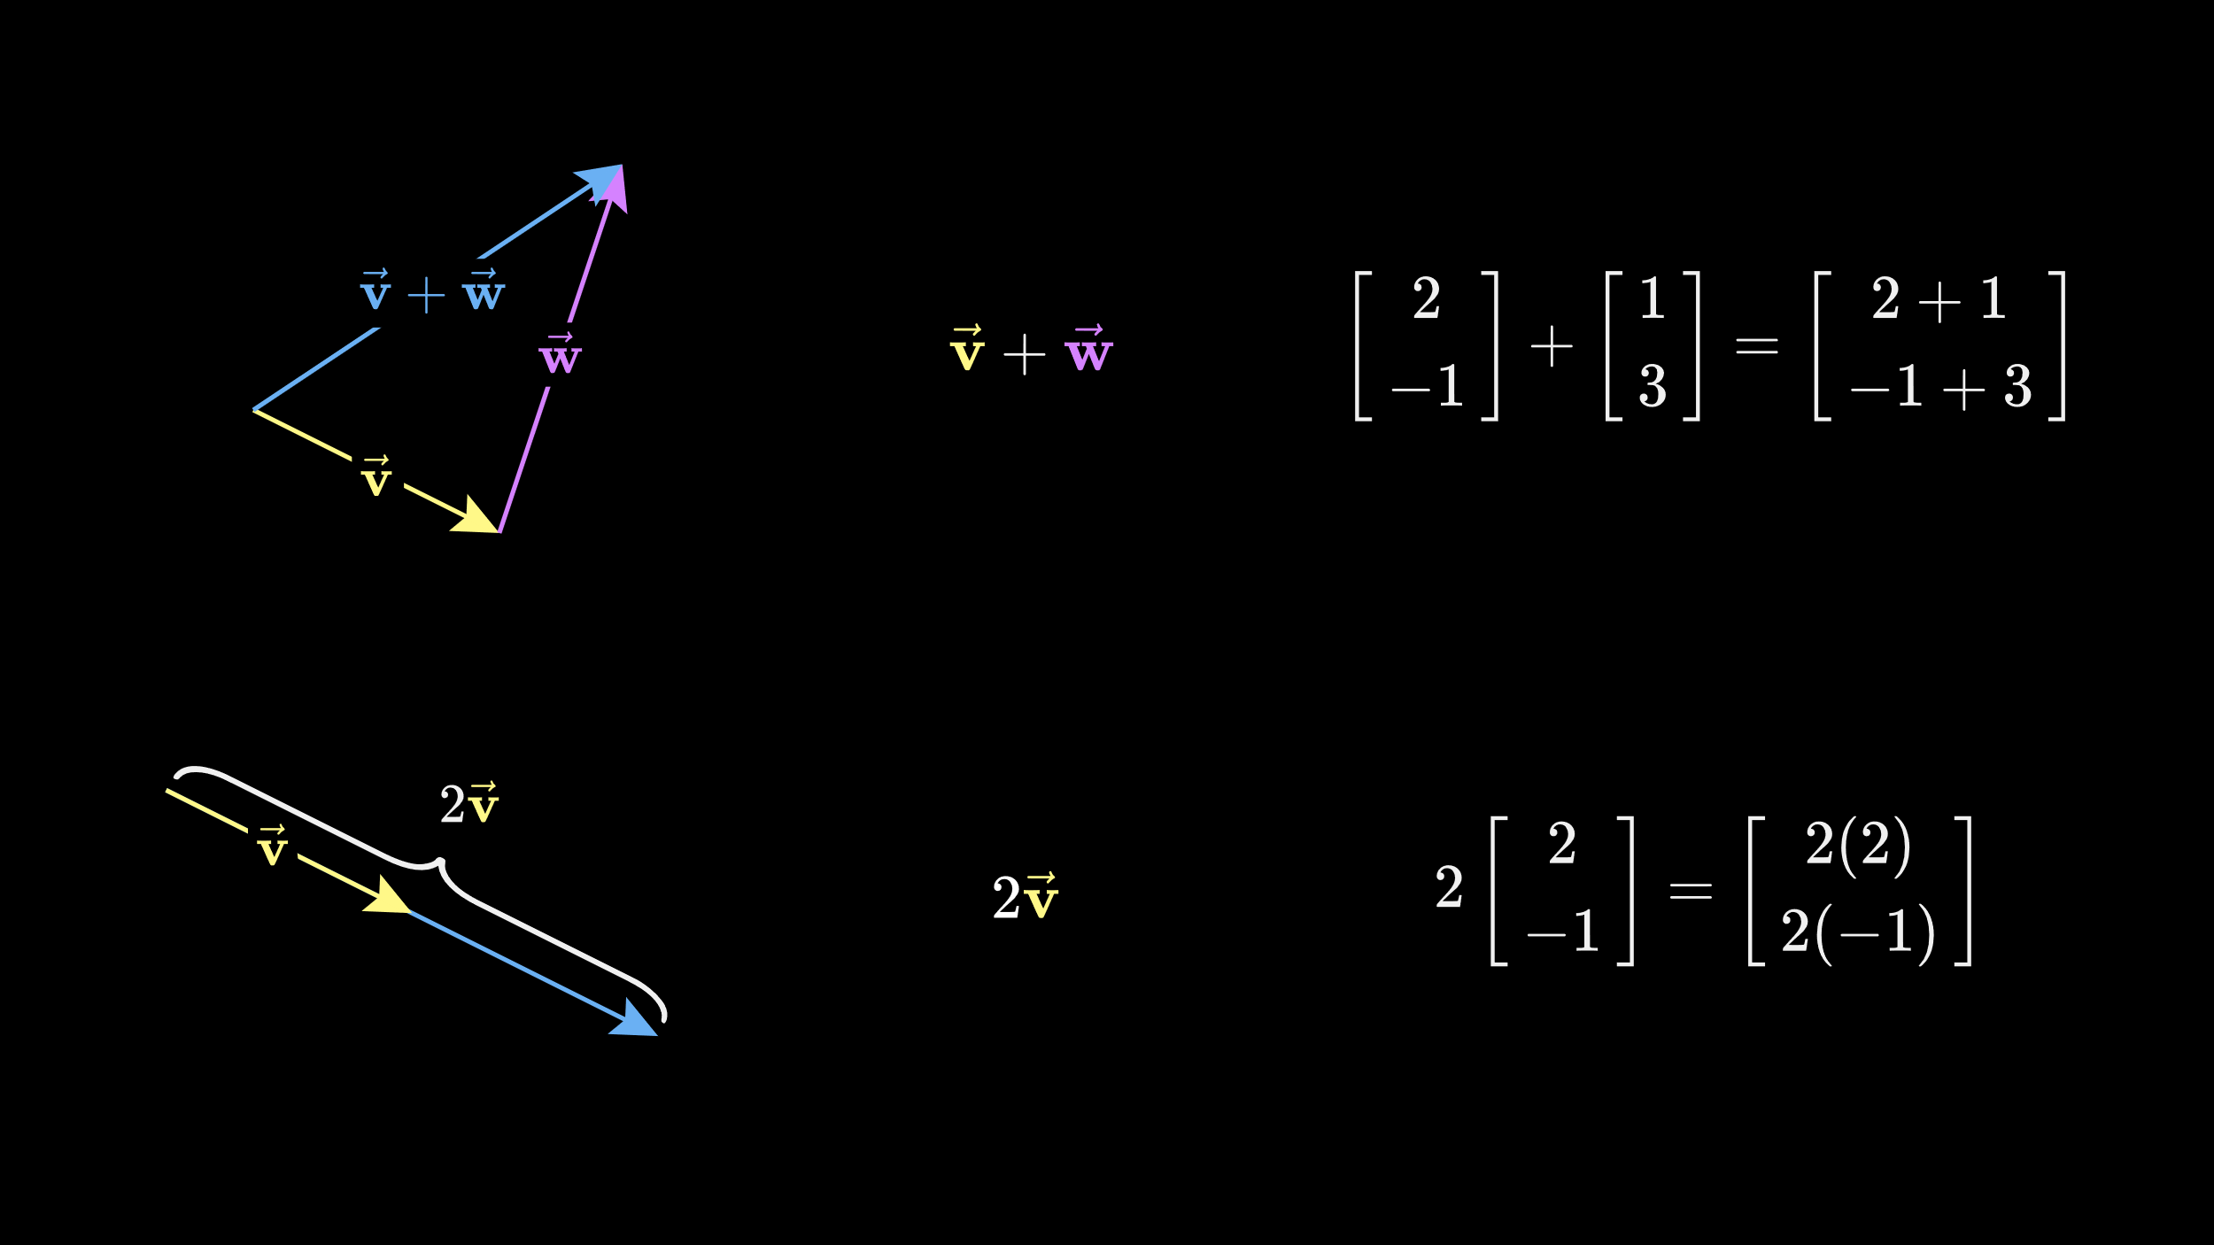
Vector Operations: Addition

Slide 24
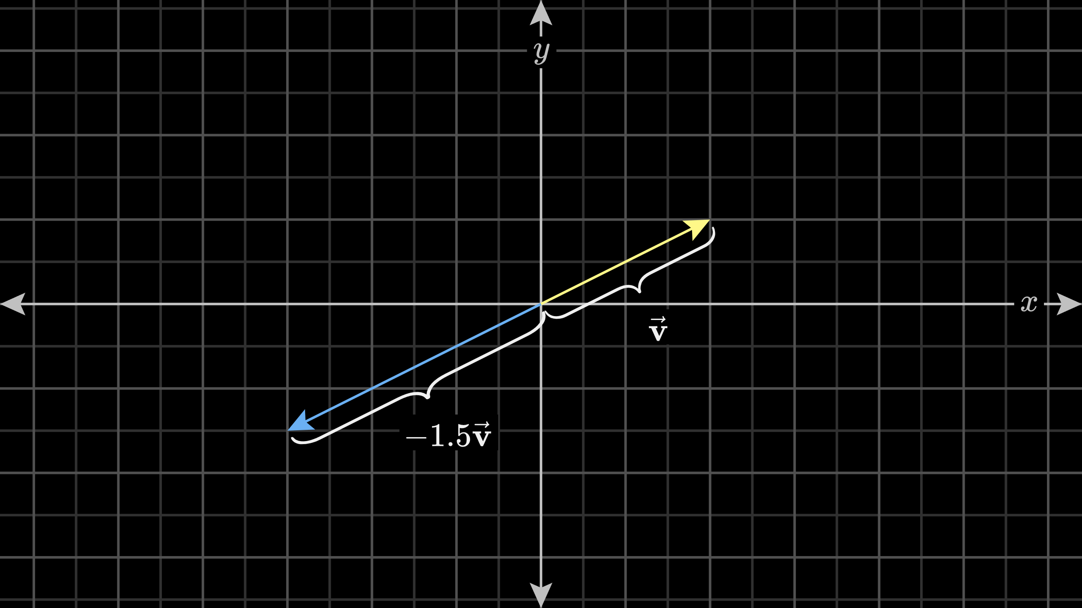
Vector Operations: Scaling

Slide 25
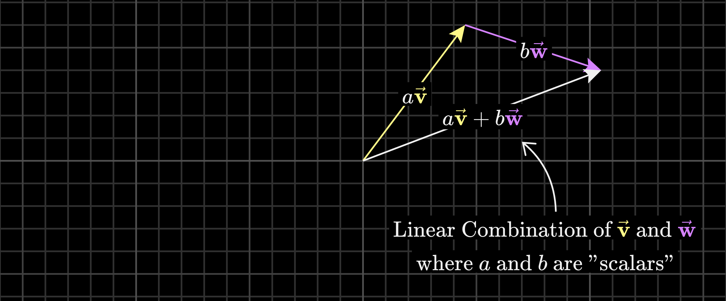
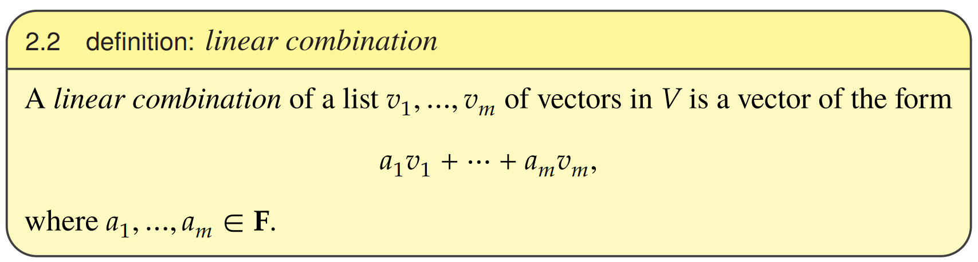
Linear Combinations
Linear Algebra Done Right, Sheldon Axler

Slide 26
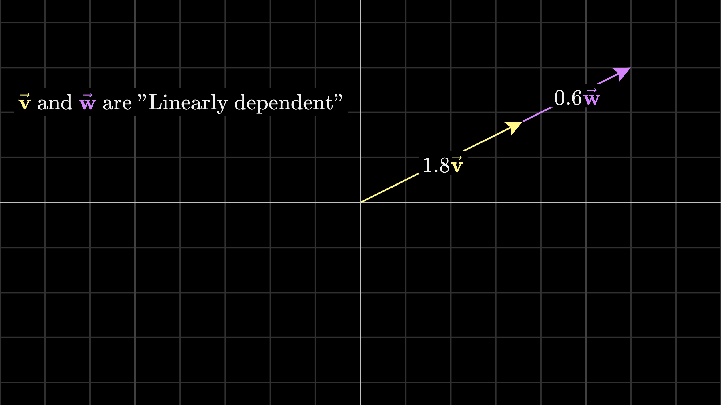
Linear dependence
Notes:
one of the vectors can be expressed as a linear combination of the others. That is, it's already in the span of the other two.

Slide 27
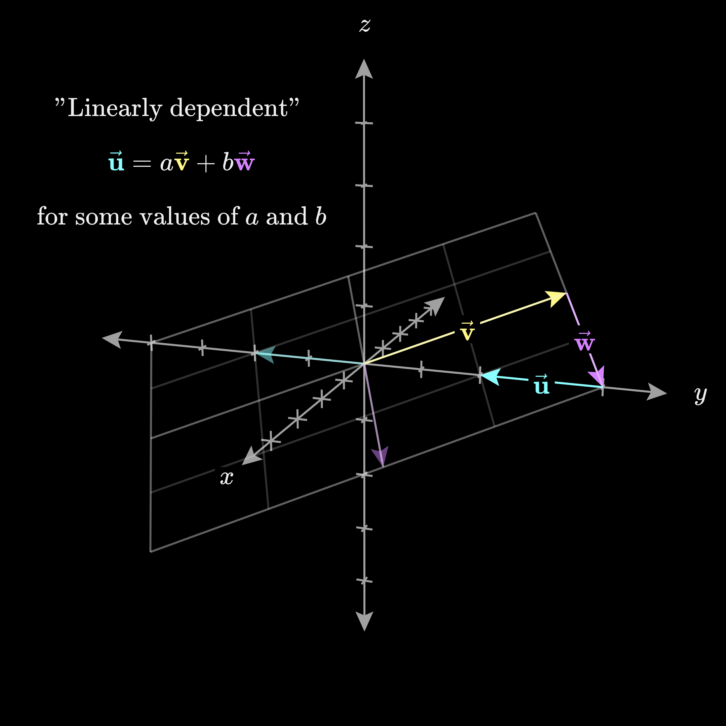
Linear dependence

Slide 28
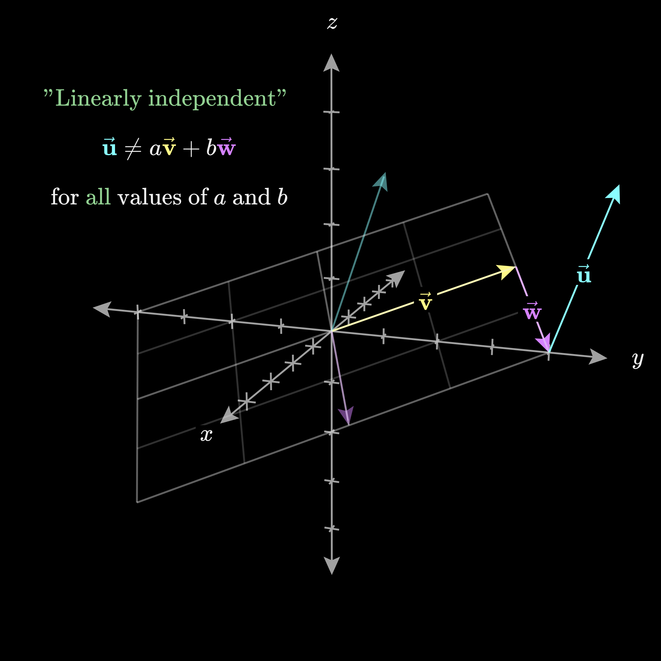
Linear independence

Slide 29
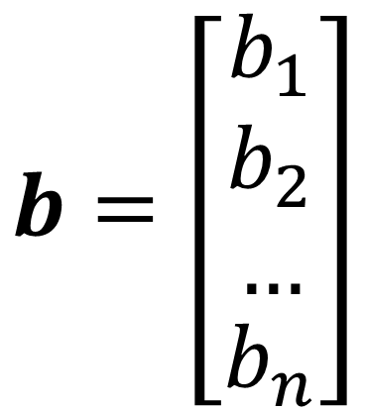
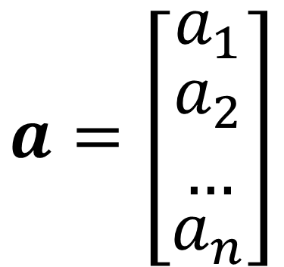
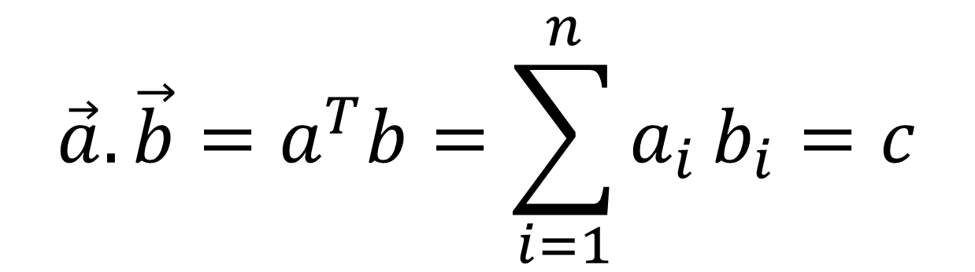
Vector operations: Dot product
$$b=\left[\begin{matrix}b_{1} \\ \begin{aligned}b_{2} \\ …\end{aligned} \\ b_{n}\end{matrix}\right]$$
$$a=\left[\begin{matrix}a_{1} \\ \begin{aligned}a_{2} \\ …\end{aligned} \\ a_{n}\end{matrix}\right]$$
$$\vec{a}.\vec{b}=a^{T}b=\sum_{i=1}^{n}{a_{i}}b_{i}=c$$

Slide 30
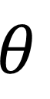
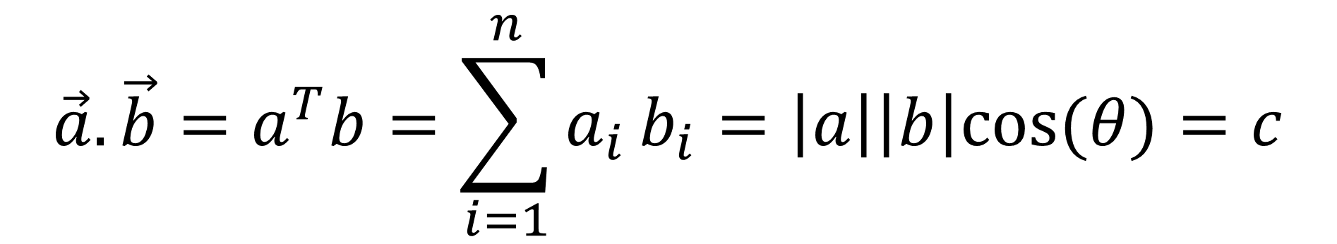
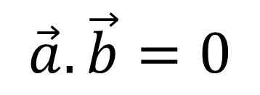
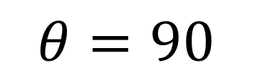
Dot product: a geometric interpretation
$$\vec{a}.\vec{b}=a^{T}b=\sum_{i=1}^{n}{a_{i}}b_{i}=\left|a\right|\left|b\right|cos⁡(θ)=c$$
$$\vec{a}.\vec{b}=0$$
$$θ$$
$$θ=90$$

Slide 31

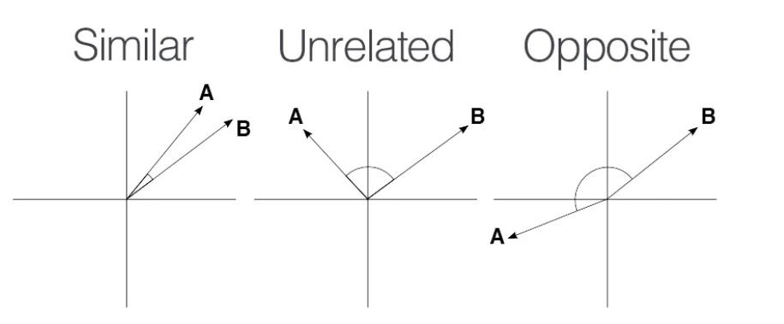
Cosine Similarity

Slide 32
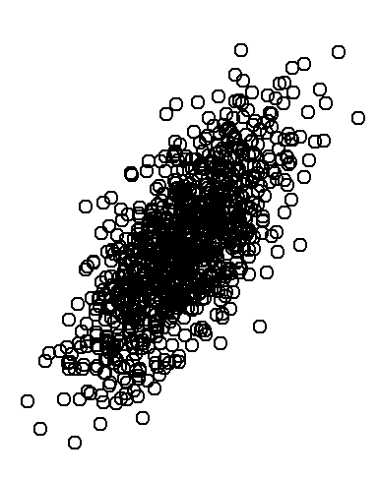
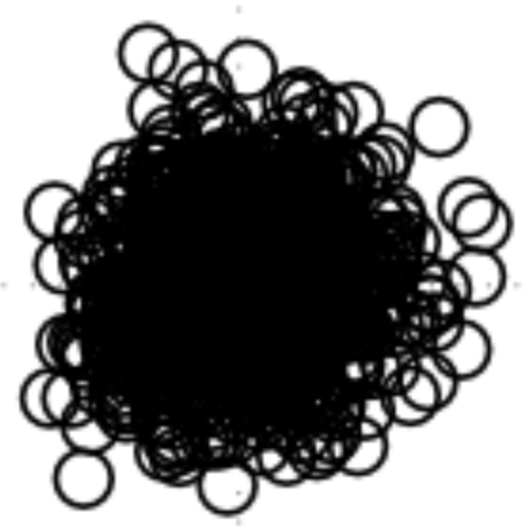
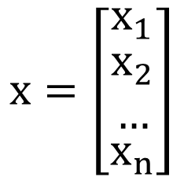
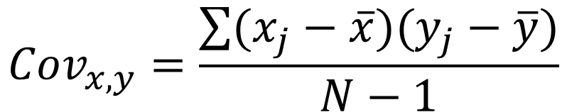
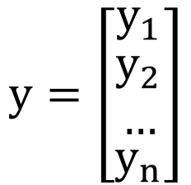
Dot product and covariance
$$x=\left[\begin{matrix}x_{1} \\ \begin{aligned}x_{2} \\ …\end{aligned} \\ x_{n}\end{matrix}\right]$$
$$y=\left[\begin{matrix}y_{1} \\ \begin{aligned}y_{2} \\ …\end{aligned} \\ y_{n}\end{matrix}\right]$$
$${Cov}_{x,y}=\frac{\sum{(x_{j}−\overline{x})(y_{j}−\overline{y})}}{N−1}$$

Slide 33
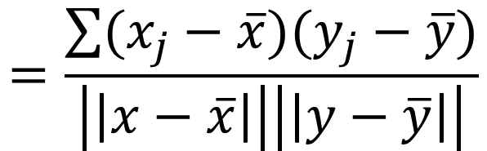
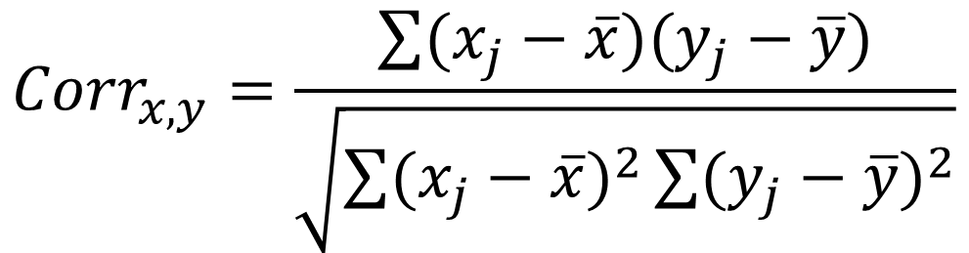
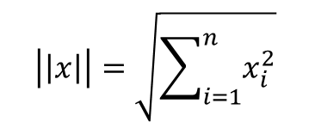
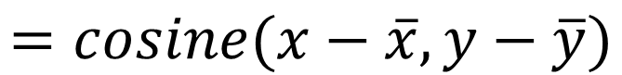
Dot product and correlation
$${Corr}_{x,y}=\frac{\sum{(x_{j}−\overline{x})(y_{j}−\overline{y})}}{\sqrt{\sum{{(x_{j}−\overline{x})}^{2}}\sum{{(y_{j}−\overline{y})}^{2}}}}$$
$$=\frac{\sum{(x_{j}−\overline{x})(y_{j}−\overline{y})}}{\left|\left|x−\overline{x}\right|\right|\left|\left|y−\overline{y}\right|\right|}$$
$$\left|\left|x\right|\right|=\sqrt{\sum_{i=1}^{n}{x_{i}^{2}}}$$
$$=cosine(x−\overline{x},y−\overline{y})$$

Slide 34
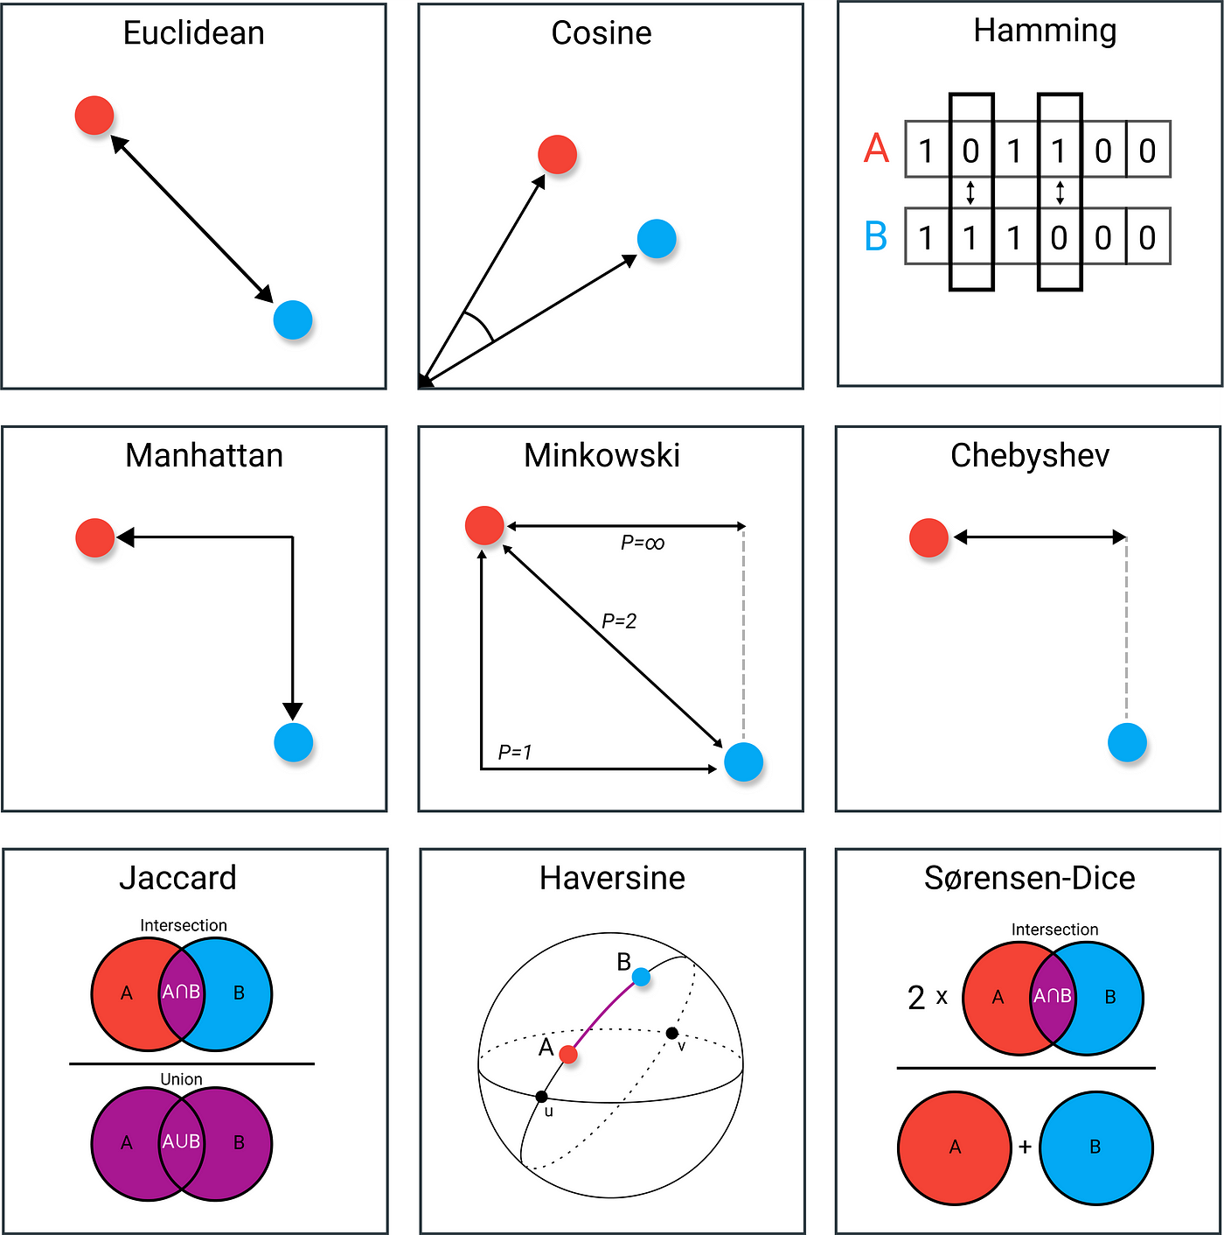
Distance Measures in Data Science

Slide 35
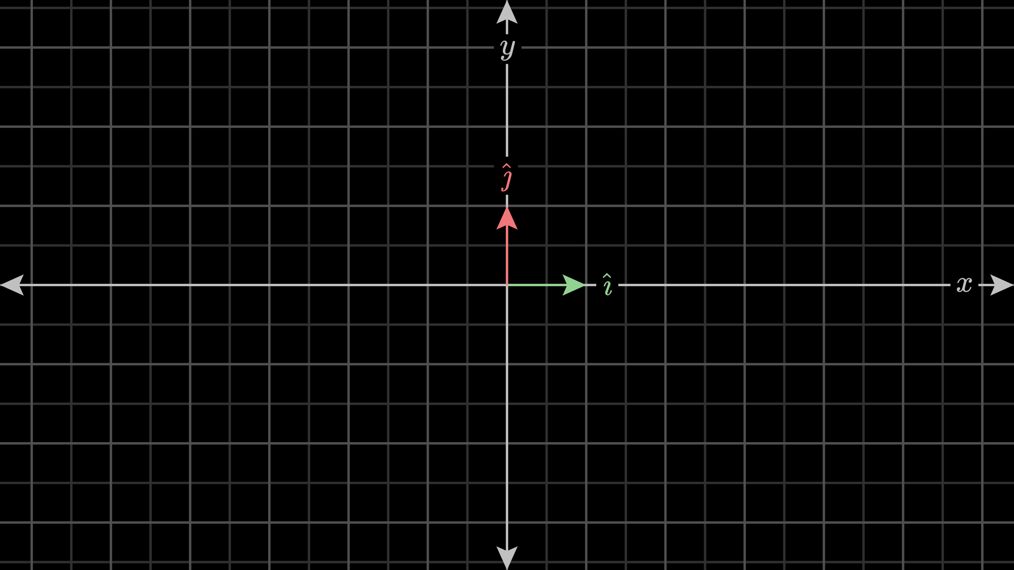
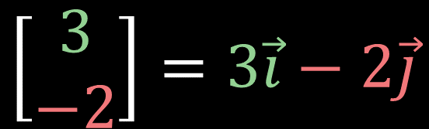
Basis vectors
$$\left[\begin{matrix}3 \\ −2\end{matrix}\right]=3\vec{i}−2\vec{j}$$
Notes:
When you have a pair of numbers meant to describe a vector, like (3,−2)(3,−2), think of each coordinate as a scalar, meaning think about how each one stretches or squishes vectors.
Now, think of the 𝑥x-coordinate as a scalar that scales ı^^, stretching it by a factor of 33, and the 𝑦y-coordinate as a scalar that scales ȷ^^​, flipping it and stretching it by a factor of 22. In this sense, the vector that these coordinates describe is the sum of two scaled vectors.

Slide 36


Basis vectors and span
A basis of $V$ is a list of vectors in $V$ that is linearly independent and spans $V$.
In mathematics, the linear span of a set S of vectors is defined as the set of all linear combinations of the vectors in S.
Notes:
This idea of adding together two scaled vectors is a surprisingly important concept. Those two vectors ı^^ and ȷ^^​ have a special name: Together they are called the "basis" of the coordinate system. What this means is that when you think about coordinates as scalars, the basis vectors are what those scalars actually scale.

Slide 37

Choosing Different
Basis Vectors

Slide 38

Choosing Different
Basis Vectors

Slide 39
Summary

Slide 40
Matrix

Slide 41

Matrix

Slide 42

Matrix
A rectangular array of numbers is called a matrix. The horizontal arrays of a matrix are called its rows and the vertical arrays are called its columns. A matrix A having m rows and n columns is said to be a matrix of size/ order m × n and can be represented in either of the following forms:
$$A={\left[\begin{matrix}a_{11} & \begin{matrix}a_{12} & … & a_{1n}\end{matrix} \\ \begin{matrix}a_{21} \\ ⋮ \\ a_{m1}\end{matrix} & \begin{matrix}\begin{matrix}a_{22} & … & a_{2n}\end{matrix} \\ \begin{matrix}⋮ & ⋱ & ⋮\end{matrix} \\ \begin{matrix}a_{m2} & … & a_{mn}\end{matrix}\end{matrix}\end{matrix}\right]}_{m×n}$$
Matrix Dimension
Linear Algebra through Matrices, Arbind K Lal and Sukant Pati

Slide 43

Matrix Operations: Addition
$$\left[\begin{matrix}a & b \\ c & d\end{matrix}\right]+\left[\begin{matrix}e & f \\ g & h\end{matrix}\right]=\left[\begin{matrix}a+e & b+f \\ c+g & d+h\end{matrix}\right]$$
a matrix can only be added to another matrix if the two matrices have the same dimensions .

Slide 44

Matrix operations:
Scalar Multiplication
$$λ\left[\begin{matrix}a & b \\ c & d\end{matrix}\right]=\left[\begin{matrix}λa & λb \\ λc & λd\end{matrix}\right]$$

Slide 45

Matrix operations: multiplication
$$\left[\begin{matrix}a & b \\ c & d\end{matrix}\right]\left[\begin{matrix}x \\ y\end{matrix}\right]=x\left[\begin{matrix}a \\ c\end{matrix}\right]+y\left[\begin{matrix}b \\ d\end{matrix}\right]=\left[\begin{matrix}ax+by \\ cx+dy\end{matrix}\right]$$

Slide 46

Matrix operations: multiplication
$$\left[\begin{matrix}a & b \\ c & d\end{matrix}\right]\left[\begin{matrix}e & g \\ f & h\end{matrix}\right]=\left[\begin{matrix}ae+bf & ag+bh \\ ce+df & cg+dh\end{matrix}\right]$$

Slide 47
Matrix operations: multiplication
$$\left[\begin{matrix}a & b \\ c & d\end{matrix}\right]\left[\begin{matrix}e & g \\ f & h\end{matrix}\right]=\left[\begin{matrix}ae+bf & ag+bh \\ ce+df & cg+dh\end{matrix}\right]$$

Slide 48

Matrix operations: multiplication
You can only multiply matrices if the number of columns of the first matrix is the same as the number of rows as the second matrix: $A_{m×n}×B_{n×p}=C_{m×p}$

Slide 49
Matrix operations: multiplication
we can operationally define matrix multiplication as the dot product of the rows of the first matrix with the columns of the second matrix.

Slide 50






Matrix operations: Transpose
$$A$$
$$A^{T}$$
$$\left[\begin{matrix}1 & 2 & 3 \\ 4 & 5 & 6 \\ 7 & 8 & 9\end{matrix}\right]$$
$$\left[\begin{matrix}1 & 4 & 7 \\ 2 & 5 & 8 \\ 3 & 6 & 9\end{matrix}\right]$$
$$\left[\begin{matrix}1 & 2 & 3 \\ 4 & 5 & 6\end{matrix}\right]$$
$$\left[\begin{matrix}1 & 4 \\ 2 & 5 \\ 3 & 6\end{matrix}\right]$$

Slide 51
Linear transformations

Slide 52

Transformation
Our original square under different types of transformations: (A) stretched, (B) compressed, (C) rotated, (D) reflected or flipped, and (E) sheared.
https://gregorygundersen.com/blog/2018/12/10/svd/
Notes:
The only constraint is that our transformation must be linear. Intuitively, a linear transformation is one in which a straight line before the transformation results in a straight line after the transformation.

Slide 53

Linear and Nonlinear Transformation
(A) Our original square under a linear transformation M (B) and a nonlinear transformation M (C).
https://gregorygundersen.com/blog/2018/12/10/svd/
Notes:
The only constraint is that our transformation must be linear. Intuitively, a linear transformation is one in which a straight line before the transformation results in a straight line after the transformation.

Slide 54


Linear Transformation

Slide 55

Linear Transformation

Slide 56

Linear Transformation

Slide 57



Identity Matrix
$$\left[\begin{matrix}1 & ⋯ & 0 \\ ⋮ & ⋱ & ⋮ \\ 0 & ⋯ & 1\end{matrix}\right]$$
$$\left[\begin{matrix}a & ⋯ & b \\ ⋮ & ⋱ & ⋮ \\ c & ⋯ & d\end{matrix}\right]=\left[\begin{matrix}a & ⋯ & b \\ ⋮ & ⋱ & ⋮ \\ c & ⋯ & d\end{matrix}\right]$$
https://mathinsight.org/applet/linear_transformation_2d
https://integral-domain.org/lwilliams/Applets/algebra/linearTransformations.php

Slide 58



Scalar Matrix
$$\left[\begin{matrix}C & ⋯ & 0 \\ ⋮ & ⋱ & ⋮ \\ 0 & ⋯ & C\end{matrix}\right]$$
$$\left[\begin{matrix}a & ⋯ & b \\ ⋮ & ⋱ & ⋮ \\ c & ⋯ & d\end{matrix}\right]=\left[\begin{matrix}Ca & ⋯ & Cb \\ ⋮ & ⋱ & ⋮ \\ Cc & ⋯ & Cd\end{matrix}\right]$$
https://mathinsight.org/applet/linear_transformation_2d
https://integral-domain.org/lwilliams/Applets/algebra/linearTransformations.php

Slide 59




Off by one matrix
$$\left[\begin{matrix}2 & ⋯ & 0 \\ ⋮ & ⋱ & ⋮ \\ 0 & ⋯ & 1\end{matrix}\right]$$
$$\left[\begin{matrix}a & ⋯ & b \\ ⋮ & ⋱ & ⋮ \\ c & ⋯ & d\end{matrix}\right]$$
https://mathinsight.org/applet/linear_transformation_2d
https://integral-domain.org/lwilliams/Applets/algebra/linearTransformations.php
Notes:
Scale the x-axis by k
Scale the y-axis by k

Slide 60



Off by one matrix
$$\left[\begin{matrix}−1 & ⋯ & 0 \\ ⋮ & ⋱ & ⋮ \\ 0 & ⋯ & 1\end{matrix}\right]$$
$$\left[\begin{matrix}a & ⋯ & b \\ ⋮ & ⋱ & ⋮ \\ c & ⋯ & d\end{matrix}\right]$$
https://mathinsight.org/applet/linear_transformation_2d
https://integral-domain.org/lwilliams/Applets/algebra/linearTransformations.php
Notes:
Scale the x-axis by k
Scale the y-axis by k

Slide 61


Orthogonal Matrix
Square matrix
All column vectors are orthogonal
$$\left[\begin{matrix}−2 & 3 \\ 3 & 2\end{matrix}\right]$$
Visualize Different Matrices part2 | SEE Matrix, Chapter 1
https://www.desmos.com/calculator/u8wt5rnw9n
Notes:
Scale the x-axis by k
Scale the y-axis by k

Slide 62


Orthogonal Matrix
Square matrix
All column vectors are orthogonal
$$\left[\begin{matrix}−2 & 3 \\ 3 & 2\end{matrix}\right]$$
Visualize Different Matrices part2 | SEE Matrix, Chapter 1
https://www.desmos.com/calculator/u8wt5rnw9n https://integral-domain.org/lwilliams/Applets/algebra/linearTransformations.php
Notes:
Scale the x-axis by k
Scale the y-axis by k

Slide 63


Orthogonal Matrix
Square matrix
All column vectors are orthogonal
All column vectors are unit vectors
$$\left[\begin{matrix}0.5 & {\sqrt{3}}/2 \\ −{\sqrt{3}}/2 & 0.5\end{matrix}\right]$$
Visualize Different Matrices part2 | SEE Matrix, Chapter 1
https://www.desmos.com/calculator/u8wt5rnw9n https://www.geogebra.org/m/pDU4peV5
Notes:
Scale the x-axis by k
Scale the y-axis by k

Slide 64


Projection Matrix
A projection matrix is a special type of square matrix that, when multiplied by a vector, projects that vector onto a certain subspace.
Visualize Different Matrices part2 | SEE Matrix, Chapter 1
https://www.desmos.com/calculator/u8wt5rnw9n https://integral-domain.org/lwilliams/Applets/algebra/linearTransformations.php
Notes:
Scale the x-axis by k
Scale the y-axis by k

Slide 65


Projection Matrix
A projection matrix is a special type of square matrix that, when multiplied by a vector, projects that vector onto a certain subspace.
$$\left[\begin{matrix}0.2 & 0.4 \\ 0.4 & 0.8\end{matrix}\right]$$
Visualize Different Matrices part2 | SEE Matrix, Chapter 1
https://www.desmos.com/calculator/u8wt5rnw9n https://integral-domain.org/lwilliams/Applets/algebra/linearTransformations.php
Notes:
Scale the x-axis by k
Scale the y-axis by k

Slide 66
Projection Matrix
A projection matrix is a special type of square matrix that, when multiplied by a vector, projects that vector onto a certain subspace.
Visualize Different Matrices part2 | SEE Matrix, Chapter 1
https://www.desmos.com/calculator/u8wt5rnw9n https://integral-domain.org/lwilliams/Applets/algebra/linearTransformations.php
Notes:
In linear regression, projection matrices play a crucial role in deriving the best fit line for a set of data points. The relationship between projection matrices and linear regression centers around how data vectors are projected from higher-dimensional space onto a subspace spanned by the predictors (or independent variables) in the regression model. Here’s a more detailed breakdown of this relationship:

Slide 67

Composition of
linear transformations
$$A.B=C$$
Transformation 1
Transformation 2
Combined Transformation
Matrix multiplication: Composition of Sequential Transformations

Slide 68





Composition of linear transformations
$\left[\begin{matrix}−2 & 0 \\ 0 & −3\end{matrix}\right] = \left[\begin{matrix}−1 & 0 \\ 0 & −1\end{matrix}\right]$ $\left[\begin{matrix}2 & 0 \\ 0 & 1\end{matrix}\right]$ $\left[\begin{matrix}1 & 0 \\ 0 & 3\end{matrix}\right]$

Slide 69

Linear transformations is a function
Notes:
Transformations Are Functions

Slide 70

Linear transformations is a function
Notes:
Transformations Are Functions

Slide 72
Neurosyntax Academy
@neurosyntaxacademy
@Neuro_Syntax
neurosyntax

Slide 73
Session 2
Lecturer: Saman Abbaspoor

Slide 74

Summary:
Matrix as a Linear transformations
Notes:
Transformations Are Functions

Slide 75










Magnitude of a vector
(Euclidean norm)
$$\left\|\vec{u}\right\|$$
$$v_{2}$$
$$\left\|\vec{u}\right\|=\sqrt{v_{1}^{2}+v_{2}^{2}}$$
$$v_{1}$$
$$\left\|\vec{u}\right\|=\sqrt{v_{1}^{2}+v_{2}^{2}+v_{3}^{2}}$$
$$\left\|\vec{u}\right\|$$
$$\left\|\vec{u}\right\|=\sqrt{v_{1}^{2}+v_{2}^{2}+…+v_{n}^{2}}=\sqrt{\sum_{i=1}^{n}{v_{i}^{2}}}$$
$$v_{3}$$
$$v_{2}$$
$$v_{1}$$
Notes:
Pythagorean theorem

Slide 76




Euclidean norm and variance
$$\left\|\vec{u}\right\|=\sqrt{v_{1}^{2}+v_{2}^{2}+…+v_{n}^{2}}=\sqrt{\sum_{i=1}^{n}{v_{i}^{2}}}$$
$$\left[\begin{matrix}v_{1} \\ v_{2} \\ \begin{aligned}⋮ \\ v_{n}\end{aligned}\end{matrix}\right]$$
$$s^{2}=\frac{\sum_{i=1}^{n}{{(v_{i}−\overline{v})}^{2}}}{n−1}$$
$${\frac{1}{n}\left\|\vec{u}\right\|}^{2}=s^{2}$$
Notes:
Pythagorean theorem

Slide 77
Matrix decomposition and principal component analysis (PCA)

Slide 78


Patterns: correlated structures
Data matrix
Covariance matrix
$$Cov(x_{i},x_{j})$$
$$Cov(x_{i},x_{i})$$

Slide 79

Principal component analysis (PCA)
Eigendecomposition of the data covariance matrix

Slide 80

Correlation space
Notes:
2. the color-coded correlation matrix of 197 neurons based on the mRNA profiles of 1 745 differentially expressed genes

Slide 81


Examples of covariance/correlation matrices
Functional Connectivity in the Brain
Gene expression profile in neurons
Bullmore and Sporns, Nature Reviews 2009
Li et al., Cell Research 2016
Notes:
2. the color-coded correlation matrix of 197 neurons based on the mRNA profiles of 1 745 differentially expressed genes

Slide 82






Compute covariance/correlation matrix
$$\overline{X}=\frac{1}{n}\sum_{j=1}^{n}{X_{j}}$$
$$B=X−\overline{X}$$
$$C=B^{T}B$$
$B=zscore\left(x\right)$[for correlation]
$$\left[\begin{matrix}x_{1} & y_{1} \\ x_{2} & y_{2} \\ \begin{aligned}⋮ \\ x_{3}\end{aligned} & \begin{aligned}⋮ \\ y_{3}\end{aligned}\end{matrix}\right]$$
Mean Centering

Slide 83
Dot product and covariance
$$x=\left[\begin{matrix}x_{1} \\ \begin{aligned}x_{2} \\ …\end{aligned} \\ x_{n}\end{matrix}\right]$$
$$y=\left[\begin{matrix}y_{1} \\ \begin{aligned}y_{2} \\ …\end{aligned} \\ y_{n}\end{matrix}\right]$$
$${Cov}_{x,y}=\frac{\sum{(x_{j}−\overline{x})(y_{j}−\overline{y})}}{N−1}$$

Slide 84



$$B=X−\overline{X}$$
Covariance Matrix
$${Cov}_{x,y}=\frac{\sum{(x_{j}−\overline{x})(y_{j}−\overline{y})}}{N−1}$$
$$C=B^{T}B$$

Slide 85




Dot product and correlation
$${Corr}_{x,y}=\frac{\sum{(x_{j}−\overline{x})(y_{j}−\overline{y})}}{\sqrt{\sum{{(x_{j}−\overline{x})}^{2}}\sum{{(y_{j}−\overline{y})}^{2}}}}$$
$$=\frac{\sum{(x_{j}−\overline{x})(y_{j}−\overline{y})}}{\left|\left|x−\overline{x}\right|\right|\left|\left|y−\overline{y}\right|\right|}$$
$$\left|\left|x\right|\right|=\sqrt{\sum_{i=1}^{n}{x_{i}^{2}}}$$
$$=cosine(x−\overline{x},y−\overline{y})$$

Slide 86





Correlation Matrix
$${Corr}_{x,y}=\frac{\sum{(x_{j}−\overline{x})(y_{j}−\overline{y})}}{\sqrt{\sum{{(x_{j}−\overline{x})}^{2}}\sum{{(y_{j}−\overline{y})}^{2}}}}$$
[Mean = 0
Var = 1]
Total Var =
n columns
$$\overline{X}=\frac{1}{n}\sum_{j=1}^{n}{X_{j}}$$
$$B=zscore\left(X\right)=\frac{x−\overline{x}}{σ}$$
Correlation Matrix
[-1, 1]
$$C=B^{T}B$$
$$C=B^{T}B$$

Slide 87
Principal component analysis (PCA)
Eigendecomposition of the data covariance matrix

Slide 88

Principal component analysis (PCA)

Slide 89
Composition of
linear transformations
$$A.B=C$$
Transformation 1
Transformation 2
Combined Transformation
Matrix multiplication: Composition of Sequential Transformations

Slide 90

Matrix decomposition
$\left[X\right]=$
Combined Transformation
(square matrix)
Simple Transformation
Visualize Different Matrices part2 | SEE Matrix, Chapter 1
Notes:
In linear regression, projection matrices play a crucial role in deriving the best fit line for a set of data points. The relationship between projection matrices and linear regression centers around how data vectors are projected from higher-dimensional space onto a subspace spanned by the predictors (or independent variables) in the regression model. Here’s a more detailed breakdown of this relationship:

Slide 91














Eigendecomposition
$$A=VΛV^{T}$$
$$T$$
$$λ_{1}$$
$$0$$
$$=$$
$$V_{1}$$
$$V_{2}$$
$$V_{3}$$
$$λ_{2}$$
$$V_{1}$$
$$V_{2}$$
$$V_{3}$$
$$0$$
$$λ_{3}$$
Eigenvectors
(Orthogonal)
Eigenvalues
(Diagonal)
Notes:
In linear regression, projection matrices play a crucial role in deriving the best fit line for a set of data points. The relationship between projection matrices and linear regression centers around how data vectors are projected from higher-dimensional space onto a subspace spanned by the predictors (or independent variables) in the regression model. Here’s a more detailed breakdown of this relationship:

Slide 92




Eigendecomposition
$$Av=λv$$
$$Av=λv=λIv$$
$$(A−λI)v=0$$
$$det\left(A−λI\right)=0$$
For more details check Session 2 - Differential equations and dynamical systems on the Youtube of Neurosyntax academy: https://www.youtube.com/@neurosyntaxacademy

Slide 93


Eigenvectors of a symmetric matrix
https://dept.math.lsa.umich.edu/~speyer/LinearAlgebraVideos/Lecture10a.pdf

Slide 94



Geometric intuitions of Eigendecomposition
$$A=PDP^{−1}$$
https://www.cs.toronto.edu/~michael/teaching/csc311_w23/tutorials/tut7.pdf
Notes:
In linear regression, projection matrices play a crucial role in deriving the best fit line for a set of data points. The relationship between projection matrices and linear regression centers around how data vectors are projected from higher-dimensional space onto a subspace spanned by the predictors (or independent variables) in the regression model. Here’s a more detailed breakdown of this relationship:

Slide 95















Eigendecomposition
$$λ_{1}$$
$$0$$
$$=$$
$$V_{1}$$
$$V_{2}$$
$$V_{3}$$
$$V_{1}$$
$$V_{2}$$
$$V_{3}$$
$$λ_{2}$$
$$0$$
$$λ_{3}$$
$$λ\overset{⃑}{v}$$
$$A\overset{⃑}{v}=λ\overset{⃑}{v}$$
Each eigenvalue in Principal Component Analysis (PCA) indeed tells us how much of the total data variance is explained after projecting the data onto its corresponding eigenvector.
$$\overset{⃑}{v}$$
Notes:
In linear regression, projection matrices play a crucial role in deriving the best fit line for a set of data points. The relationship between projection matrices and linear regression centers around how data vectors are projected from higher-dimensional space onto a subspace spanned by the predictors (or independent variables) in the regression model. Here’s a more detailed breakdown of this relationship:

Slide 96
Principal component analysis (PCA)

Slide 97



Explained Variance
$$EV=1−\frac{Var[Y−\hat{Y}]}{Var[Y]}$$
Scree plot
$$λ_{i}=\frac{λ_{i}}{\sum_{j=1}^{p}{λ_{j}}}$$
Explained Variance (%)
Eigenvalue

Slide 98
Dimensionality Reduction

Slide 99


Component analysis,
dimensionality reduction and
change in basis vectors
Change in basis
Correlation
in data
Uninformative axis
Dimensionality
Reduction
Original data in $R^{2}$
Total variance of data can
be represented in $R^{1}$

Slide 100


Component analysis,
dimensionality reduction and
change in basis vectors
Change in basis
Dimensionality Reduction
Original data in $R^{2}$
Partial variance of data can
be represented in $R^{1}$

Slide 101


Slide 102



Dimensionality Reduction
$$λ_{i}=\frac{λ_{i}}{\sum_{j=1}^{p}{λ_{j}}}$$
Explained Variance (%)
$$X_{n×m}V_{m×k}=R_{n×k}$$
$$k<m$$
Eigenvalue

Slide 103







Matrix Decomposition and Dimensionality Reduction
$$x_{ij}≈\sum_{r=1}^{R}{λ_{i}^{r}v_{j}^{r}}$$
$$A$$
$$Λ$$
$$V^{T}$$
$$≈$$
$$=$$
$$+…+$$
Dimensionality Reduction for Matrix- and Tensor-Coded Data [Part 1]

Slide 104




Dimensionality Reduction
$$D_{6×t}$$
$$D_{t×6}^{T}$$
Explained Variance (%)
Eigenvalue
$$C_{n×n}=V_{n×n}Λ_{n×n}V_{n×n}^{T}$$
$${\hat{D}}_{t×r}=D_{t×n}^{T}V_{n×r};r<n$$

Slide 105


Dimensionality Reduction
$$D_{6×t}$$
$$D_{t×6}^{T}$$
Explained Variance (%)
Eigenvalue
$$C_{6×6}=V_{6×6}Λ_{6×6}V_{6×6}^{T}$$
$${\hat{D}}_{t×2}=D_{t×6}^{T}V_{6×2}$$

Slide 106
Principal component analysis (PCA)

Slide 107



Dimensionality Reduction
$$D_{6×t}$$
$$D_{t×6}^{T}$$
Eigenvectors
$${\hat{D}}_{t×2}=D_{t×6}^{T}V_{6×2}$$

Slide 108

Truncation
Elbow Rule
In Component Analysis, truncation refers to the process of reducing the dimensionality of the data by selecting only a subset of principal components. This is typically done by retaining the principal components that capture the most variance and discarding those that contribute the least.

Slide 109







Marchenko–Pastur distribution
$$λ_{3}$$
$$λ_{2}$$
$$λ_{1}$$
$$0$$
$$1$$
$$λ$$
https://people.math.wisc.edu/~valko/courses/833/2009f/lec_6_7.pdf

Slide 110




Data Matrix (S*N)
Eigenvectors/Factors/Loadings
Latent Variables (S*R)
R < N
$$λ_{1}$$
$$>$$
$$λ_{2}$$
$$λ_{n}$$
PCA
Projection
…
Truncate

Slide 111



PCA: Uniqueness
-
+
In PCA, the eigenvectors (principal components), the uniqueness of these components is up to a sign, which means:
Eigenvectors:
Each eigenvector can be multiplied by -1 without changing the orientation of the principal component it represents. Both $v$ and $−v$ are valid eigenvectors corresponding to the same eigenvalue.
Eigenvalues:
Eigenvalues are unique in their magnitude, but the associated eigenvectors' direction (positive or negative) can vary.
The highest absolute weight was positive
$$if sgn\left(w_{\left|max\right|}\right)>0→V×(1)$$
$$if sgn\left(w_{\left|max\right|}\right)<0→V×(−1)$$

Slide 112

Phantom oscillations in principal component analysis, Maxwell Shinn

Slide 113

Interactive visualization
https://setosa.io/ev/principal-component-analysis/

Slide 114
PCA Assumptions and limitations

Slide 115



Slide 116


PCA Assumptions
Linearity: PCA assumes that the relationships between variables are linear.
Orthogonality: Principal components are orthogonal (uncorrelated) to each other.
Large Variance Indicates Importance: It assumes that components with larger variance are more important.
Gaussian Distribution: Assumes the data is Gaussian distributed, although this is not strictly necessary.

Slide 117



PCA Assumptions
Linearity: PCA assumes that the relationships between variables are linear.
Orthogonality: Principal components are orthogonal (uncorrelated) to each other.
Large Variance Indicates Importance: It assumes that components with larger variance are more important.
Gaussian Distribution: Assumes the data is Gaussian distributed, although this is not strictly necessary.

Slide 118

PCA Assumptions
Linearity: PCA assumes that the relationships between variables are linear.
Orthogonality: Principal components are orthogonal (uncorrelated) to each other.
Large Variance Indicates Importance: It assumes that components with larger variance are more important.
Gaussian Distribution: Assumes the data is Gaussian distributed, although this is not strictly necessary.
https://pair-code.github.io/understanding-umap/

Slide 119


PCA and UMAP performance on MNIST dataset
Notes:
let me provide you with a tangible example
Many of you may know MNIST dataset which is a large database of handwritten digits that is commonly used for training clustering algorithms

Slide 120
PCA on linearly correlated data

Slide 121

PCA on linearly correlated data with outliers

Slide 122

PCA on random noise

Slide 123


Slide 125
Neurosyntax Academy
@neurosyntaxacademy
@Neuro_Syntax
neurosyntax

Slide 126
Session 3
Lecturer: Saman Abbaspoor

Slide 127
Principal Component Analysis (PCA)
Dimensionality Reduction
Computation
Phantom oscillations in principal component analysis, Maxwell Shinn

Slide 128
Principal Component Analysis (PCA)
PCA is one of the best-known technique in multivariate analysis, tackling data compression and statistical pattern recognition in a dataset. The idea is to extract features, making a domain transformation of the input in a way that a reduced number of features retaining most of the explanatory capacity can be selected. The PCA algorithm is the optimum linear transformation in the mean square error sense, resulting in a set of linearly uncorrelated variables, the so-called principal components (PCs), representing the directions that maximize the rate of variance decrease.
Traditional PCA has limitations when dealing with high order dependencies, since it's a linear method, is independent of the data source, having no tunable parameters, and, when applied to classification problems, assigns each new sample strictly based on what was observed on the training period, not updating statistical properties dynamically.
S. Haykin, Neural Networks and Learning Machines, 3rd ed., 2009.

Slide 129



Information beyond covariance structure?

Slide 130
PCA Applications

Slide 132


World Happiness Report
https://worldhappiness.report/ed/2021/happiness-trust-and-deaths-under-covid-19/
Download: https://public.tableau.com/views/Figure2_1_16157724652500/2021WorldHappinessReport?:showVizHome=no

Slide 133


World Happiness Report

Slide 135

Https://www.kaggle.com/datasets/brunogrisci/breast-cancer-gene-expression-cumida

Slide 136

Visualization and Clustering
N-dimensional space

Slide 137

https://human.brain-map.org/static/download

Slide 138
PCA Applications in Neuroscience (Patterns in Timeseries)

Slide 139
Cell assemblies

Slide 140


Hebb’s idea: cell assembly dynamics support cognitive processes
Cell assembly, defined as groups of neurons displaying recurring patterns of coordinated activity
Harris., 2005; Hebb., 1949; Buzsaki., 2010; Yuste et al., 2024
Notes:
In 1949, Hebb introduced the term “cell assembly” to define a group of neurons that are frequently coactive, thereby establishing strong interconnections, and acting together as a functional unit which could underlie cognitive function
Because of their high interconnectivity, a partial sensory cue that can stimulate a sufficient number of assembly members can activate the entire assembly (pattern completion)
An important prerequisite of cell assembly definition is that the same assembly might also be triggered spontaneously by internal factors.
The chaining of such assemblies, ‘‘phase sequences’’, in turn, would provide the basis by which complex cognitive processes, such as memory recall, thinking, planning, and decision-making

Slide 141


Cell Assembly
Sakurai, 1998
Harris et al., Nature 2003
Notes:
Linear correlation

Slide 142





Detecting cell assemblies in large neuronal populations
Notes:
We can study the neural dynamics of a brain circuit at different levels.
We can study oscillations,
Spiking activity, and it’s relationship with the oscillations,
Or cell assembly composition and its structuring via oscillations
For the remaining 3 parts of the talk, I will focus on these different levels of analysis and how I used them to study CA1 dynamics organization

Slide 143

Detecting cell assemblies in large neuronal populations
Lopes-dos-Santos et al., Plos One 2011; Lopes-dos-Santos, JNeuro Method 2013
Tingley and Peyrache et al., Phil. Trans. R. Soc. B 2020
Makdah et al., BioRxiv 2024
Notes:
We can study the neural dynamics of a brain circuit at different levels.
We can study oscillations,
Spiking activity, and it’s relationship with the oscillations,
Or cell assembly composition and its structuring via oscillations
For the remaining 3 parts of the talk, I will focus on these different levels of analysis and how I used them to study CA1 dynamics organization

Slide 144


Tracking cell assembly activation/reactivation over time
$$R_{k}\left(t\right)={z\left(t\right)}^{T}P_{k}z(t)$$
Activation at each time point is the weighted average of firing of cells in the spike matrix with weights coming from each PCA/ICA component
Notes:
We can study the neural dynamics of a brain circuit at different levels.
We can study oscillations,
Spiking activity, and it’s relationship with the oscillations,
Or cell assembly composition and its structuring via oscillations
For the remaining 3 parts of the talk, I will focus on these different levels of analysis and how I used them to study CA1 dynamics organization

Slide 146



Membership overlap in cell assemblies:
violation of orthogonality
Notes:
However, some limitations exist when two assemblies share neurons: in this case, the NA shared neurons firing patterns, as captured by the covariance matrix, would result in PCs with diverse weight patterns associated to those neurons who constitute the assembly, thus impairing the NA membership identification [12, 13].

Slide 147

Detecting cell assemblies in large neuronal populations
Notes:
We can study the neural dynamics of a brain circuit at different levels.
We can study oscillations,
Spiking activity, and it’s relationship with the oscillations,
Or cell assembly composition and its structuring via oscillations
For the remaining 3 parts of the talk, I will focus on these different levels of analysis and how I used them to study CA1 dynamics organization

Slide 148



Detecting cell assemblies in large neuronal populations
Spike Matrix
Neuron#
Apply ICA
$$×$$
Cmp#
Time
Notes:
We can study the neural dynamics of a brain circuit at different levels.
We can study oscillations,
Spiking activity, and it’s relationship with the oscillations,
Or cell assembly composition and its structuring via oscillations
For the remaining 3 parts of the talk, I will focus on these different levels of analysis and how I used them to study CA1 dynamics organization

Slide 150
Cell assemblies at multiple time scales
with arbitrary lag constellations
Russo and Durstewitz, eLife 2017

Slide 151

Unsupervised discovery of temporal sequences in high-dimensional datasets, with applications to neuroscience
Mackevicius et al., eLife 2019

Slide 152


Temporal smoothing
Time bin
Measuring and interpreting neuronal correlations, Cohen and Kohn, Nature Neuroscience 2011

Slide 153



Physiologically interpretable and systematic estimation of cell assembly time constant
Pairwise cross-correlogram
Generalized linear model (GLM)
Peer Prediction
Spivak et al., Nat Comm Bio, 2022
Kobayashi et al., Nat Comm, 2019
Harris et al., Nature, 2003
https://github.com/EranStarkLab/CCH-deconvolution
https://github.com/NII-Kobayashi/GLMCC
bz_peerPrediction.m
https://github.com/buzsakilab/buzcode

Slide 154

PCA for assemblies containing patterns
of neural interactions with inhibition
Pompili et al., bioRxiv, 2024

Slide 155





Cell assembly analysis
Weight
Saman Abbaspoor and Kari L. Hoffman, Cell Reports 2024

Slide 156




Examples in the literature
Peyrache et al., Nat Neuro 2009
Oliva et al., Nature 2020
Umbach et al., Nat Comm 2022

Slide 158
Neurosyntax Academy
@neurosyntaxacademy
@Neuro_Syntax
neurosyntax

Slide 159
Session 4
Lecturer: Saman Abbaspoor

Slide 160
Principal Component Analysis (PCA)
Dimensionality Reduction
Computation
Phantom oscillations in principal component analysis, Maxwell Shinn

Slide 161
Interpreting loadings and scores
$$R_{k}\left(t\right)={z\left(t\right)}^{T}P_{k}z(t)$$
Activation at each time point is the weighted average of firing of cells in the spike matrix with weights coming from each PCA/ICA component
Notes:
We can study the neural dynamics of a brain circuit at different levels.
We can study oscillations,
Spiking activity, and it’s relationship with the oscillations,
Or cell assembly composition and its structuring via oscillations
For the remaining 3 parts of the talk, I will focus on these different levels of analysis and how I used them to study CA1 dynamics organization

Slide 162
Neural Manifold

Slide 163


Neural trajectory of parallel spike trains
$$\left[\begin{matrix}0.06 \\ 0.01\end{matrix}\right]$$
| | || | ||| | |||| | ||||| | ||| | … | |
| | | | || | || | |||| | ||||| |  | |||
Neuron
Time
$$\left[\begin{matrix}0.06 \\ 0.04\end{matrix}\right]$$
Neuron 2
0.02 | 0.04 | 0.06 | 0.08 | 0.1 | 0.06 | … | 0.02
0.02 | 0.02 | 0.04 | 0.04 | 0.08 | 0.01 | … | 0.06
Neuron 1
Notes:
We can study the neural dynamics of a brain circuit at different levels.
We can study oscillations,
Spiking activity, and it’s relationship with the oscillations,
Or cell assembly composition and its structuring via oscillations
For the remaining 3 parts of the talk, I will focus on these different levels of analysis and how I used them to study CA1 dynamics organization

Slide 164

Neural trajectory of parallel spike trains
Yu et al., J Neurophysiol 2009
Notes:
We can study the neural dynamics of a brain circuit at different levels.
We can study oscillations,
Spiking activity, and it’s relationship with the oscillations,
Or cell assembly composition and its structuring via oscillations
For the remaining 3 parts of the talk, I will focus on these different levels of analysis and how I used them to study CA1 dynamics organization

Slide 165


Dimensionality reduction for
large-scale neural recordings
Spiking Activity
Latent State Space
Neuron #
Dim 2
Time
Dim 1
https://elephant.readthedocs.io/en/latest/tutorials/gpfa.html
Notes:
We can study the neural dynamics of a brain circuit at different levels.
We can study oscillations,
Spiking activity, and it’s relationship with the oscillations,
Or cell assembly composition and its structuring via oscillations
For the remaining 3 parts of the talk, I will focus on these different levels of analysis and how I used them to study CA1 dynamics organization

Slide 166



Strong and weak principles
of neural dimension reduction
The weak principle is that dimension reduction is a convenient tool for making sense of complex neural data.
The strong principle is that dimension reduction shows us the true latent signal(s) encoded by a population of neurons and so moves us closer to how neural circuits actually operate and compute.
Humphries, arXiv 2023
Notes:
In statistics, latent variables (from Latin: present participle of lateo, “lie hidden”) are variables that can only be inferred indirectly through a mathematical model from other observable variables that can be directly observed or measured.

Slide 167




Constraints on dynamics in high-dimensional spaces
Gallego et al., Nature communication 2018; Cunningham & Yu, Nature neuroscience 2014

Slide 168

Manifold hypothesis
The manifold hypothesis is that real-world high dimensional data lie on low-dimensional manifolds embedded in the high-dimensional space. The main idea here is that even though our real-world data is high-dimensional, there is actually some lower-dimensional representation.
The intrinsic dimensionality of a space is the number of required pieces of information that we need to describe each object in the space. This may differ from the number of pieces of information that we are using, which we call the extrinsic dimensionality of the space.
https://mbernste.github.io/posts/intrinsic_dimensionality/

Slide 169


Slide 170

Examining intrinsic and embedding dimensionality
The intrinsic dimension is the minimal number of continuous variables needed to parametrize the manifold. In contrast, the embedding dimension is a measure of the number of dimensions explored by the manifold within the ambient Euclidean space.
Jazayeri, Ostojic Curr Opin Neurobiol. 2021

Slide 171




Intrinsic Dimension Estimation
Altan et al., Plos Computational Biology 2021

Slide 172

Recognizing latent structures in the environment
In statistics, latent variables are variables that can only be inferred indirectly through a mathematical model from other observable variables that can be directly observed or measured.
Notes:
In statistics, latent variables (from Latin: present participle of lateo, “lie hidden”) are variables that can only be inferred indirectly through a mathematical model from other observable variables that can be directly observed or measured.

Slide 173


Assumption: Latent state generative model of neural population
Task: Inferring Latent Dynamics Underlying Neural Population Activity
https://elephant.readthedocs.io/en/latest/tutorials/gpfa.html
Notes:
Latent variable models assume that neural activity is generated by a set of low-dimensional latent states.
Conceptually, we have a generative model which maps latent factors z(t) to neural observations x(t) via a mapping function f and a noise model. The latent factors evolve according to their dynamics D. A central goal of the dimensionality reduction technique is learn an inference function φ which maps neural observations x(t) to latent factors z(t). This inference function could be as simple as matrix multiplication or as complex as an implicit function implemented by a multi-step optimization procedure.

Slide 174







Assumption: Latent state generative model of neural population
Task: Inferring Latent Dynamics Underlying Neural Population Activity
$$inference φ$$
$$x(t)$$
$$z(t)$$
$$generation f \\ +noise$$
$$D(t)$$
The strong principle is that dimension reduction shows us the true underlying signal embodied by the neural circuit, the so-called "latent signal." It is a theory that the brain really is low-dimensional compared to the number of neurons. The joint activity of a population of neurons is a (noisy) realization of this low-dimensional system—a realization using many more elements (neurons) than dimensions in the system.
https://elephant.readthedocs.io/en/latest/tutorials/gpfa.html; Humphries, arXiv 2023
Notes:
Latent variable models assume that neural activity is generated by a set of low-dimensional latent states.
Conceptually, we have a generative model which maps latent factors z(t) to neural observations x(t) via a mapping function f and a noise model. The latent factors evolve according to their dynamics D. A central goal of the dimensionality reduction technique is learn an inference function φ which maps neural observations x(t) to latent factors z(t). This inference function could be as simple as matrix multiplication or as complex as an implicit function implemented by a multi-step optimization procedure.

Slide 176

Matrix Representation of Trial-Structured Neural Data
Unsupervised Discovery of Demixed, LowDimensional Neural Dynamics across Multiple
Timescales through Tensor Component Analysis, Williams, 2018

Slide 177

Tensor Representation of Trial-Structured Neural Data
Unsupervised Discovery of Demixed, LowDimensional Neural Dynamics across Multiple
Timescales through Tensor Component Analysis, Williams, 2018

Slide 178

https://users.ece.cmu.edu/~byronyu/software/DataHigh/datahigh.html
Notes:
We can study the neural dynamics of a brain circuit at different levels.
We can study oscillations,
Spiking activity, and it’s relationship with the oscillations,
Or cell assembly composition and its structuring via oscillations
For the remaining 3 parts of the talk, I will focus on these different levels of analysis and how I used them to study CA1 dynamics organization

Slide 179

Data High
DataHigh is a Matlab-based graphical user interface to visualize and interact with high-dimensional neural population activity.
https://users.ece.cmu.edu/~byronyu/software/DataHigh/datahigh.html

Slide 181

Ames, and Churchland, eLife 2019

Slide 182
PCA Assumptions
While PCA itself does not make assumptions about the data, the most popular interpretation of PCA does.
This classic interpretation posits that patterns in the loadings or scores indicate some latent underlying patterns in the data. This interpretation relies on four assumptions and may be misleading if those assumptions are violated.
First, the underlying patterns must exist and be independent of one another.
Second, they must combine linearly to form the observed data.
Third, the data must contain exclusively these patterns and additive, uncorrelated noise.
Fourth, observations must be independent. When any of these does not hold, the above interpretation of PCA may not hold.
Phantom oscillations in principal component analysis, Maxwell Shinn

Slide 183

Phantom oscillations in principal component analysis, Maxwell Shinn

Slide 184
Component Analysis, Manifold Learning, State-space models, and Applications

Slide 185

Correlational Correspondence between Intrinsic Neural Manifold and the Manifold of the Measured Behavioral Variables
Jazayeri and Afraz, Neuron 2017
Notes:
Latent variable models assume that neural activity is generated by a set of low-dimensional latent states.
Conceptually, we have a generative model which maps latent factors z(t) to neural observations x(t) via a mapping function f and a noise model. The latent factors evolve according to their dynamics D. A central goal of the dimensionality reduction technique is learn an inference function φ which maps neural observations x(t) to latent factors z(t). This inference function could be as simple as matrix multiplication or as complex as an implicit function implemented by a multi-step optimization procedure.

Slide 186

Signal components and their behavioral correlates
Dimensionality reduction in neuroscience Rich Pang et al. 2016

Slide 187

Comparisons of neural recordings across
time, across subsets of neurons and across
individuals requires the alignment of
low-dimensional latent representations
Dabagia et al., nature biomedical engineering 2023
Notes:
We can study the neural dynamics of a brain circuit at different levels.
We can study oscillations,
Spiking activity, and it’s relationship with the oscillations,
Or cell assembly composition and its structuring via oscillations
For the remaining 3 parts of the talk, I will focus on these different levels of analysis and how I used them to study CA1 dynamics organization

Slide 188

Signal components and their behavioral correlates
Gallego et al., Nature Neuroscience 2020
Notes:
We can study the neural dynamics of a brain circuit at different levels.
We can study oscillations,
Spiking activity, and it’s relationship with the oscillations,
Or cell assembly composition and its structuring via oscillations
For the remaining 3 parts of the talk, I will focus on these different levels of analysis and how I used them to study CA1 dynamics organization

Slide 189


Signal components and their behavioral correlates
Gallego et al., Nature Neuroscience 2020
Notes:
We can study the neural dynamics of a brain circuit at different levels.
We can study oscillations,
Spiking activity, and it’s relationship with the oscillations,
Or cell assembly composition and its structuring via oscillations
For the remaining 3 parts of the talk, I will focus on these different levels of analysis and how I used them to study CA1 dynamics organization

Slide 190

Preserved neural dynamics across animals performing similar behaviour
Safaie et al., nature 2023
Notes:
We can study the neural dynamics of a brain circuit at different levels.
We can study oscillations,
Spiking activity, and it’s relationship with the oscillations,
Or cell assembly composition and its structuring via oscillations
For the remaining 3 parts of the talk, I will focus on these different levels of analysis and how I used them to study CA1 dynamics organization

Slide 191

Manifold learning and characterization
Chaudhuri et al., Nature Neuroscience 2019
Notes:
We can study the neural dynamics of a brain circuit at different levels.
We can study oscillations,
Spiking activity, and it’s relationship with the oscillations,
Or cell assembly composition and its structuring via oscillations
For the remaining 3 parts of the talk, I will focus on these different levels of analysis and how I used them to study CA1 dynamics organization

Slide 192
Assumption: Latent state generative model of neural population
Task: Inferring Latent Dynamics Underlying Neural Population Activity
$$inference φ$$
$$x(t)$$
$$z(t)$$
$$generation f \\ +noise$$
$$D(t)$$
The strong principle is that dimension reduction shows us the true underlying signal embodied by the neural circuit, the so-called "latent signal." It is a theory that the brain really is low-dimensional compared to the number of neurons. The joint activity of a population of neurons is a (noisy) realization of this low-dimensional system—a realization using many more elements (neurons) than dimensions in the system.
https://elephant.readthedocs.io/en/latest/tutorials/gpfa.html; Humphries, arXiv 2023
Notes:
Latent variable models assume that neural activity is generated by a set of low-dimensional latent states.
Conceptually, we have a generative model which maps latent factors z(t) to neural observations x(t) via a mapping function f and a noise model. The latent factors evolve according to their dynamics D. A central goal of the dimensionality reduction technique is learn an inference function φ which maps neural observations x(t) to latent factors z(t). This inference function could be as simple as matrix multiplication or as complex as an implicit function implemented by a multi-step optimization procedure.

Slide 193

Assumption: Latent state generative model of neural population
Task: Inferring Latent Dynamics Underlying Neural Population Activity
Cunningham and Yu., Nature Neuroscience 2023
Notes:
Conceptually, we have a generative model which maps latent factors z(t) to neural observations x(t) via a mapping function f and a noise model. The latent factors evolve according to their dynamics D. A central goal of the dimensionality reduction technique is learn an inference function φ which maps neural observations x(t) to latent factors z(t). This inference function could be as simple as matrix multiplication or as complex as an implicit function implemented by a multi-step optimization procedure.

Slide 194



Assumption: Latent state generative model of neural population
Task: Inferring Latent Dynamics Underlying Neural Population Activity
In PCA, the mapping function $f$ is an instantaneous linear function and the noise is Gaussian (in the probabilistic extension of PCA). The dynamics are not explicitly modeled. The inference function is the matrix inverse of the mapping function
Cunningham and Yu., Nature Neuroscience 2023
Notes:
Conceptually, we have a generative model which maps latent factors z(t) to neural observations x(t) via a mapping function f and a noise model. The latent factors evolve according to their dynamics D. A central goal of the dimensionality reduction technique is learn an inference function φ which maps neural observations x(t) to latent factors z(t). This inference function could be as simple as matrix multiplication or as complex as an implicit function implemented by a multi-step optimization procedure.

Slide 195

Assumption: Latent state generative model of neural population
Task: Inferring Latent Dynamics Underlying Neural Population Activity
Raut et al., bioRxiv 2023
Notes:
We can study the neural dynamics of a brain circuit at different levels.
We can study oscillations,
Spiking activity, and it’s relationship with the oscillations,
Or cell assembly composition and its structuring via oscillations
For the remaining 3 parts of the talk, I will focus on these different levels of analysis and how I used them to study CA1 dynamics organization

Slide 196

Assumption: Latent state generative model of neural population
Task: Inferring Latent Dynamics Underlying Neural Population Activity
Hurwitz et al., arXiv 2021
Notes:
Latent variable models assume that neural activity is generated by a set of low-dimensional latent states.
Conceptually, we have a generative model which maps latent factors z(t) to neural observations x(t) via a mapping function f and a noise model. The latent factors evolve according to their dynamics D. A central goal of the dimensionality reduction technique is learn an inference function φ which maps neural observations x(t) to latent factors z(t). This inference function could be as simple as matrix multiplication or as complex as an implicit function implemented by a multi-step optimization procedure.

Slide 197
References
Dimensionality reduction for large-scale neural recordings, Cunningham and Yu., Nature Neuroscience 2014
Neural population geometry and optimal coding of tasks with shared latent structure Albert J. Wakhloo et al., arXiv 2024
Strong and weak principles of neural dimension reduction, Mark D. Humphries. arXiv 2023
Building population models for large-scale neural recordings: opportunities and pitfalls, Cole Hurwitz., arXiv 2021
Modeling behaviorally relevant neural dynamics enabled by preferential subspace identification, Sani, et al. Nature Neuroscience 2019
Large-scale neural recordings call for new insights to link brain and behavior, Urai, et al., Nature Neuroscience, 2022
Neural population geometry: An approach for understanding biological and artificial neural networks, Chung and Abbott. Current opinion in neurobiology, 2021
Dimensionality reduction in neuroscience. Pang et al., Current Biology, 2016
On simplicity and complexity in the brave new world of large-scale neuroscience. Gao P, Ganguli S., Curr Opin Neurobiol 2015
Navigating the Neural Space in Search of the Neural Code, Jazayeri and Afraz, Neuron 2017
Computation Through Neural Population Dynamics. Vyas et al. Annu Rev Neurosci 2020
A theory of multineuronal dimensionality, dynamics, and measurement. Gao et al. bioRxiv 2017
Is population activity more than the sum of its parts? Pillow and Aoi, Nature Neuroscience 2017
Structure in neural population recordings: an expected byproduct of simpler phenomena? Elsayed and Cunningham, Nature Neuroscience 2017
The role of untuned neurons in sensory information coding, Zylberberg, bioRxiv 2018
Linking Connectivity, Dynamics, and Computations in Low-Rank Recurrent Neural Networks. Mastrogiuseppe and Ostojic. Neuron 2018
Compressed Sensing, Sparsity, and Dimensionality in Neuronal Information Processing and Data Analysis, Ganguli and Sompolinsky, Annu. Rev. Neurosci. 2012

Slide 199
Neurosyntax Academy
@neurosyntaxacademy
@Neuro_Syntax
neurosyntax

Slide 200
Session 5
Lecturer: Saman Abbaspoor

Slide 201
Singular Value Decomposition SVD

Slide 202
Principal Component Analysis (PCA)
Dimensionality Reduction
Computation
Phantom oscillations in principal component analysis, Maxwell Shinn

Slide 203


Singular Value Decomposition
No restriction on Symmetry, Dimension, Rank
$$M=UΣV^{∗}$$

Slide 204

Singular Value Decomposition
No restriction on Symmetry, Dimension, Rank
$$M=UΣV^{∗}$$
Orthogonal
Rectangular
Diagonal
Orthogonal

Slide 205














$$A$$
$$M×N$$
$$M×M$$
$$N×N$$
$$AA^{T}=S_{L}$$
$$A^{T}A=S_{R}$$
$$…$$
$$…$$
$$V_{1}$$
$$V_{2}$$
$$V_{m}$$
$$V_{1}$$
$$V_{2}$$
$$V_{n}$$

Slide 206















$$λ_{1}$$
$$λ_{2}$$
$$λ_{m}$$
$S_{L}$ and $S_{R}$ are PSD (positive semi-definite) matrices
$$…$$
$$V_{1}$$
$$V_{2}$$
$$V_{m}$$
Eigenvalues corresponding to each eigenvector is nonnegative
$$λ_{1∗}$$
$$λ_{2∗}$$
$$λ_{n∗}$$
After sorting eigenvalues in descending orders,
$$λ_{1}=λ_{1∗}>λ_{2}=λ_{2∗}>λ_{n}=λ_{n∗}>0$$
$$…$$
$$V_{1}$$
$$V_{2}$$
$$V_{n}$$
$$\left(λ>λ_{n}=λ_{n∗}\right)=0$$

Slide 207

Singular Value Decomposition
No restriction on Symmetry, Dimension, Rank
Singular Value Decomposition (SVD) applications; pillowlab 2021

Slide 208








Eigenvalues of matrix A
$$\sqrt{λ_{1}}$$
$$\sqrt{λ_{2}}$$
$$…$$
$$\sqrt{λ_{n}}$$
$$σ_{1}$$
$$σ_{2}$$
$$…$$
$$σ_{n}$$
Singular values of matrix A

Slide 209




$$svd\left(AA^{T}\right)?$$
$$A=UΣV^{∗}$$
$$AA^{T}=(UΣV^{∗})(VΣU^{∗})$$
$$AA^{T}=(UΣ^{2}U^{T})$$
$$svd\left(AA^{T}\right)=eig\left(AA^{T}\right)=pca\left(AA^{T}\right)[if A is standardized]$$

Slide 210






$$A$$
$$U$$
$$Σ$$
$$V^{∗}$$
Eigenvectors of $S_{L}$
Eigenvectors of $S_{R}$
Eigenvalues

Slide 211

Greenacre et al., nature reviews methods primers 2022

Slide 212

Singular Value Decomposition
No restriction on Symmetry, Dimension, Rank

Slide 214






















Low rank approximation with SVD
$$σ_{1}$$
$$v_{1}^{T}$$
$$σ_{2}$$
$$v_{2}^{T}$$
$$=$$
$$u_{1}$$
$$u_{2}$$
$$u_{3}$$
$$σ_{3}$$
$$v_{3}^{T}$$
$$v_{1}^{T}$$
$$v_{2}^{T}$$
$$v_{3}^{T}$$
$$=$$
$$σ_{1}$$
$$u_{1}$$
$$+$$
$$σ_{2}$$
$$u_{2}$$
$$+$$
$$σ_{3}$$
$$u_{3}$$

Slide 215

Low rank approximation with SVD
https://www.mathworks.com/help/matlab/math/image-compression-with-low-rank-svd.html

Slide 216



Low rank approximation with SVD
https://dustinstansbury.github.io/theclevermachine/svd-data-compression

Slide 217

Eckard-Young Theorem
https://rich-d-wilkinson.github.io/MATH3030/3.5-lowrank.html

Slide 218








Optimal Truncation
$$X=X_{true}+ηX_{noise}$$
$$X square;η known$$
$$N(0,1)$$
Signal
$$τ=\frac{4}{\sqrt{3}}η\sqrt{n}$$
$$logσ$$
Noise
$$r$$
$$j$$
Gavish, and Donoho, arXiv 2013

Slide 219







Optimal Truncation
$$X=X_{true}+ηX_{noise}$$
Signal
$$N(0,1)$$
$$logσ$$
$$X rectangular (β=\frac{n}{m})$$
Noise
$$η unknown?$$
$$r$$
$$j$$
Gavish, and Donoho, arXiv 2013

Slide 222
Neurosyntax Academy
@neurosyntaxacademy
@Neuro_Syntax
neurosyntax

Slide 223
Session 6
Lecturer: Saman Abbaspoor

Slide 224
Singular Value Decomposition SVD

Slide 225
Singular Value Decomposition
No restriction on Symmetry, Dimension, Rank
$$M=UΣV^{∗}$$

Slide 226








Eigenvalues of matrix A
$$\sqrt{λ_{1}}$$
$$\sqrt{λ_{2}}$$
$$…$$
$$\sqrt{λ_{n}}$$
$$σ_{1}$$
$$σ_{2}$$
$$…$$
$$σ_{n}$$
Singular values of matrix A

Slide 227
$$A$$
$$M×N$$
$$M×M$$
$$N×N$$
$$AA^{T}=S_{L}$$
$$A^{T}A=S_{R}$$
$$…$$
$$…$$
$$V_{1}$$
$$V_{2}$$
$$V_{m}$$
$$V_{1}$$
$$V_{2}$$
$$V_{n}$$

Slide 228







$$Data$$
$$T×T$$
$$N×N$$
$$M×N$$
$$AA^{T}$$
$$A^{T}A$$
$$SVD=UΣV^{∗}$$

Slide 230
Low rank approximation with SVD
$$σ_{1}$$
$$v_{1}^{T}$$
$$σ_{2}$$
$$v_{2}^{T}$$
$$=$$
$$u_{1}$$
$$u_{2}$$
$$u_{3}$$
$$σ_{3}$$
$$v_{3}^{T}$$
$$v_{1}^{T}$$
$$v_{2}^{T}$$
$$v_{3}^{T}$$
$$=$$
$$σ_{1}$$
$$u_{1}$$
$$+$$
$$σ_{2}$$
$$u_{2}$$
$$+$$
$$σ_{3}$$
$$u_{3}$$

Slide 231
Low rank approximation with SVD
https://dustinstansbury.github.io/theclevermachine/svd-data-compression

Slide 232



Dominant correlation patterns from SVD
$$A$$
Electrode
$$E×T$$
Time
Temporal Modes
Spatial Modes
$$T×T$$
$$E×E$$
$$AA^{T}=S_{L}$$
$$A^{T}A=S_{R}$$

Slide 233




Dominant spatiotemporal modes in LFP
Eisenkolb et al., Cell Reports 2023
Townsend, and Gong, Plos Computational Biology 2018

Slide 235

Application of SVD in neuroscience: Firing rate tuning
https://lucid.wisc.edu/singular-value-decomposition-svd/

Slide 236

SVD for genome-wide expression data processing and modeling
Alter et al., PNAS 2000

Slide 237
Sparse PCA

Slide 238
Principal Component Analysis (PCA)
Principal component analysis (PCA) is widely used in data processing and dimensionality reduction. However, PCA suffers from the fact that each principal component is a linear combination of all the original variables, thus it is often difficult to interpret the results.
Sparse Principal Component Analysis
Hui ZOU, Trevor HASTIE, and Robert TIBSHIRANI

Slide 239
Sparsity in statistics
In statistics, sparsity refers to situations where data or model parameters predominantly contain zero or near-zero values. This characteristic often indicates that only a small number of features or variables significantly contribute to the model or analysis, enhancing interpretability, reducing complexity, and potentially improving computational efficiency.
Sparsity in Data: When a dataset is sparse, most of its elements are zeros (e.g., word counts where most words do not appear in most documents)
Sparsity in Models: Statistical and machine learning models can exploit sparsity to achieve more efficient and interpretable outcomes. Techniques such as Lasso regression or sparse PCA are designed to encourage sparsity in model coefficients, effectively performing feature selection by driving the coefficients of less relevant features to zero.

Slide 240

Sparse PCA
Without loss of much explained variance
Most variables in the loadings have 0 weights

Slide 241


Slide 242


Slide 243

https://thoth.inrialpes.fr/people/mairal/spams/

Slide 244

https://www2.imm.dtu.dk/projects/spasm/

Slide 245


Variance-Sparsity trade-off
A New Basis for Sparse Principal Component Analysis; Fan Chen and Karl Rohe https://arxiv.org/pdf/2007.00596

Slide 246

Parameter Space
Sparse Principal Component Analysis
Hui ZOU, Trevor HASTIE, and Robert TIBSHIRANI

Slide 247

Parameter Tuning
In machine learning, parameter optimization or tuning is the problem of choosing a set of optimal parameters for a learning algorithm. A parameter is a value used to control the learning process.

Slide 248

PCA as a regression problem

Slide 249
Regularization and variable selection via the elastic net Tuning [LARS-EN]
Sparse
PCA
PCA
Data
Score
Sparse
Loading
Loading
Regularization and variable selection via the elastic net
Hui Zou and Trevor Hastie, 2004

Slide 252
Neurosyntax Academy
@neurosyntaxacademy
@Neuro_Syntax
neurosyntax

Slide 253
Session 7
Lecturer: Saman Abbaspoor

Slide 254
Nonnegative
Matrix Factorization

Slide 255

The Why and How of Nonnegative Matrix Factorization, Nicolas Gillis

Slide 256


Nonnegative Matrix Factorization (NMF)
Non-negative matrix factorization (NMF) learns a parts-based representation of data, whereas principal components analysis (PCA) learn holistic representations.
The Why and How of Nonnegative Matrix Factorization, Nicolas Gillis

Slide 257











Nonnegative Matrix Factorization (NMF)
NMF approximates a matrix V with a low-rank matrix approximation $V≈WH$
It automatically extracts sparse and meaningful features from a set of nonnegative data vectors.
$$V$$
$$W$$
$$H$$
$$m×n$$
$$m×k$$
$$k×n$$
$$V≈WH;v_{i}≈Wh_{i}$$
$$≈$$
$$|\left|V−WH\right||_{F}$$
, subject to $W≥0, H≥0$

Slide 258











$$V$$
$$W$$
$$m×n$$
$$m×k$$
Reconstruct an approximation to the original data point from a linear combination of the building blocks in $W$
$$≈$$
$$…$$
Basis element
$$H$$
The ‘coordinates of a data point’ in the basis $W$
$$…$$
$$k×n$$

Slide 259

https://blog.acolyer.org/2019/02/18/the-why-and-how-of-nonnegative-matrix-factorization/

Slide 260
Nonnegative Matrix Factorization (NMF)
Nonnegative Matrix Factorization (NMF) does not inherently have the assumption of orthogonality.
Non Negative Matrix Factorizations for Intelligent Data Analysis G. Casalino et al.,

Slide 261


Timeseries Patterns and Nonnegative Matrix Factorization (NMF)

Slide 262

Timeseries Patterns and Nonnegative Matrix Factorization (NMF)
Estimating the correct number of components is important in NMF and is a parameter of most of algorithms

Slide 263


Timeseries Patterns and Nonnegative Matrix Factorization (NMF)

Slide 264

Nonnegative Matrix Factorization (NMF)
Mackevicius et al., eLife 2019

Slide 265

https://github.com/hiroyuki-kasai/NMFLibrary

Slide 266


Slide 268
Assumptions of NNMF
Non-negativity: The most fundamental assumption of NMF is that the data represented in the matrix V and the matrices W and H it factors into must be non-negative. This constraint leads to a parts-based representation because only additive, not subtractive, combinations are allowed.
Additivity: NMF assumes that the features extracted in the components matrix W combine additively to form the original dataset. This is suitable for data where the features are often additive (e.g., pixels in images or topics in documents).

Slide 269
Assumptions of NNMF
Independence and Sparsity: NMF often works best when the underlying factors are somewhat independent or sparse. In practice, this means that the features represented by W should not overlap too much, and many entries in W and H are zero or near-zero, leading to sparse representations.
Stationarity: NMF assumes that the data does not change its underlying structure over time, which makes it less suitable for time-series data where underlying factors might change.
Linearity: The model assumes a linear relationship between the components in W and the reconstructions in V. This might not hold for complex datasets where interactions between components are non-linear.

Slide 270
NNMF
Implementation

Slide 271







$$V$$
$$W$$
$$H$$
$$m×n$$
$$m×k$$
$$k×n$$
$$≈$$

Slide 272

Optimization
In the more general approach, an optimization problem consists of maximizing or minimizing a real function by systematically choosing input values from within an allowed set and computing the value of the function.
Optimization is the selection of a best element, with regard to some criteria, from some set of available alternatives.

Slide 273

Optimization
In the more general approach, an optimization problem consists of maximizing or minimizing a real function by systematically choosing input values from within an allowed set and computing the value of the function.
Optimization is the selection of a best element, with regard to some criteria, from some set of available alternatives.

Slide 274
Key Concepts in Optimization
Objective/Cost Function: This is the function that needs to be minimized or maximized. It represents a measure of "goodness" or "cost" that needs to be optimized.

Slide 275

Frobenius norm

Slide 276






Frobenius norm and SVD
Using the property that the Frobenius norm is invariant under multiplication by orthogonal matrices ($U$ and $V$ are orthogonal), we get:

Slide 277

Frobenius norm and SVD

Slide 278
Key Concepts in Optimization
Constraints: These are the limitations or requirements that the solution must satisfy.

Slide 279

Key Concepts in Optimization
Global vs. Local Optima: In optimization, a global optimum is the best possible solution out of all possible solutions, while local optima are the best solutions within a neighborhood of solutions. For many problems, finding the global optimum can be challenging, especially in non-convex optimization landscapes.

Slide 280


Concave and Convex functions
Notes:
When selecting an optimization algorithm, it is essential to consider whether the loss function is convex or non-convex. A convex loss function has only one global minimum and no local minima, making it easier to solve with a simpler optimization algorithm. However, a non-convex loss function has both local and global minima and requires an advanced optimization algorithm to find the global minimum.

Slide 281
Concave and Convex functions
Convex functions are particularly important because they have a unique global minimum. This means that if we want to optimize a convex function, we can be sure that we will always find the best solution by searching for the minimum value of the function. This makes optimization easier and more reliable.
Notes:
When selecting an optimization algorithm, it is essential to consider whether the loss function is convex or non-convex. A convex loss function has only one global minimum and no local minima, making it easier to solve with a simpler optimization algorithm. However, a non-convex loss function has both local and global minima and requires an advanced optimization algorithm to find the global minimum.

Slide 282

https://ccrma.stanford.edu/~njb/teaching/sstutorial/part2.pdf

Slide 283


Slide 284
Limitations of NNMF
Requirement for Non-negativity: Since NMF requires non-negative data, it cannot be directly applied to data that contains negative values without preprocessing (e.g., shifting all values to be positive).
Determining the Rank: Choosing the number of components k (the rank of matrices W and H) is not straightforward and typically requires domain knowledge or experimentation. Incorrect choices of kkk can lead to overfitting or underfitting.
Local Minima: NMF involves non-convex optimization problems (typically solved using iterative methods like alternating least squares or gradient descent), which can converge to local, rather than global, minima. The initialization of W and H can significantly affect the results.

Slide 285
Limitations of NNMF
Scalability: NMF computations can be intensive, particularly for large datasets, although there have been developments in more scalable algorithms.
Absence of Consensus on Evaluation Metrics: There is no universally agreed-upon way to evaluate the quality of the factorization, particularly in unsupervised learning scenarios. Common practices include using reconstruction error, but this might not always reflect the meaningfulness or usefulness of the extracted features.

Slide 286







$$V$$
$$W$$
$$H$$
$$m×n$$
$$m×k$$
$$k×n$$
$$≈$$
An important issue with NMF is that there is not guaranteed to be a single unique decomposition (in general, there might be many schemes for defining sets of basis elements).

Slide 287




NMF implementation
$$\min_{W,H≥0}{D\left(V||WH\right)}$$
$$D\left(V||\hat{V}\right)=\sum_{i,j}{{{(V}_{ij}−−{\hat{V}}_{ij})}^{2}}$$
$$D\left(V||\hat{V}\right)=\sum_{i,j}{\left(V_{ij}\log{\frac{V_{ij}}{{\hat{V}}_{i\dot{j}}}}−V_{ij}+{\hat{V}}_{ij}\right)}$$
Lee, D.D. and Seung, H.S. (1999) Learning the Parts of Objects by Nonnegative matrix Factorization. Nature
https://ccrma.stanford.edu/~njb/teaching/sstutorial/part2.pdf

Slide 288


NMF implementation
https://ccrma.stanford.edu/~njb/teaching/sstutorial/part2.pdf

Slide 289
References
Paatero, Pentti, and Unto Tapper (1994). Positive matrix factorization: A non‐negative factor model with optimal utilization of error estimates of data values. Environmetrics 5.2: 111-126.
Lee, D. D., & Seung, H. S. (1999). Learning the parts of objects by non-negative matrix factorization. Nature, 401(6755), 788-791.
Lee, D. D., & Seung, H. S. (2001). Algorithms for non-negative matrix factorization. In Advances in neural information processing systems (pp. 556-562).
Cichocki, A., Zdunek, R., Phan, A. H., & Amari, S. (2009). Nonnegative Matrix and Tensor Factorizations: Applications to Exploratory Multi-way Data Analysis and Blind Source Separation. Wiley.
Gillis, N. (2014). Introduction to Nonnegative Matrix Factorization. arXiv preprint arXiv:1401.5226.
Berry, M. W., Browne, M., Langville, A. N., Pauca, V. P., & Plemmons, R. J. (2007). Algorithms and applications for approximate nonnegative matrix factorization. Computational statistics & data analysis, 52(1), 155-173.

Slide 291
Neurosyntax Academy
@neurosyntaxacademy
@Neuro_Syntax
neurosyntax

Slide 292
Session 8
Lecturer: Saman Abbaspoor

Slide 293
Independent
Component Analysis

Slide 294









Cocktail Party Problem
Source separation, blind signal separation (BSS) or blind source separation, is the separation of a set of source signals from a set of mixed signals, without the aid of information (or with very little information) about the source signals or the mixing process.
$$S×N$$
$$N×M$$
$$S×M$$
$$S×N$$

Slide 295
Cocktail Party Problem
$$x_{1}\left(t\right)=a_{11}s_{1}+a_{12}s_{2}+a_{13}s_{3}$$
$$x_{2}\left(t\right)=a_{21}s_{1}+a_{22}s_{2}+a_{23}s_{3}$$
$$x_{3}\left(t\right)=a_{31}s_{1}+a_{32}s_{2}+a_{33}s_{3}$$

Slide 296

Cocktail Party Problem
$$x_{1}\left(t\right)=a_{11}s_{1}+a_{12}s_{2}+a_{13}s_{3}$$
$$X=AS$$
$$x_{2}\left(t\right)=a_{21}s_{1}+a_{22}s_{2}+a_{23}s_{3}$$
$$x_{3}\left(t\right)=a_{31}s_{1}+a_{32}s_{2}+a_{33}s_{3}$$

Slide 297


Statistical Properties of Independent and Mixed Signals
One approach to solving this problem would be to use some information on the statistical properties of the signals $s_{i}(t)$ to estimate the $a_{ii}$. Actually, and perhaps surprisingly, it turns out that it is enough to assume that $s_{1}(t)$, $s_{2}(t)$ and $s_{3}(t)$, at each time instant $t$, are statistically independent. This is not an unrealistic assumption in many cases, and it need not be exactly true in practice.
$$X=AS$$

Slide 299


Dice Roller
4 | 1 | 6 | 3 | 1 | 2 | 4 | 5 | 5 | 3

Slide 300
Random Variable
In the context of probability theory, a random variable is formally defined as a measurable function that maps outcomes from a sample space to the real numbers.
Sampling
Describe by a
Probability
distribution

Slide 301
Modelling timeseries as
random variables
Gamma(2,2)

Slide 302


Central Limit Theorem
In probability theory, the central limit theorem (CLT) states that, under appropriate conditions, the distribution of a normalized version of the sample mean converges to a standard normal distribution. This holds even if the original variables themselves are not normally distributed.
$$⋮$$

Slide 303

Central Limit Theorem
In probability theory, the central limit theorem (CLT) states that, under appropriate conditions, the distribution of a normalized version of the sample mean converges to a standard normal distribution. This holds even if the original variables themselves are not normally distributed.

Slide 304
Central Limit Theorem,
Non-Gaussianity and Independence
The Central Limit Theorem, a classical result in probability theory, tells that the distribution of a sum of independent random variables tends toward a Gaussian distribution, under certain conditions. Thus, a sum of two independent random variables usually has a distribution that is closer to Gaussian than any of the two original random variables.

Slide 305


Statistical Properties of Independent and Mixed Signals
$$F$$
$$T$$
Less Gaussianity
More Gaussianity

Slide 307



Optimization problem for ICA
$$X=AS$$
$$S=WX,{W=A}^{−1}$$
$$\max_{W}{I(WX)}$$
The goal is to find a linear representation of non-Gaussian data so that the components are statistically independent, or as independent as possible.

Slide 308



Measures of
non-Gaussianity/Independence
Kurtosis
Negative entropy
Minimization of mutual information
Independent component analysis: algorithms and applications A. Hyvarinen, E. Oja, 2000

Slide 309



Kurtosis
Probability density functions for selected distributions with mean 0, variance 1 and different excess kurtosis

Slide 310

Kurtosis

Slide 311

Kurtosis

Slide 312

Kurtosis

Slide 313

Independent Component Analysis (ICA) and
Blind Source Separation (BSS)
https://research.ics.aalto.fi/ica/fastica/

Slide 314

Independent Component Analysis (ICA) and
Blind Source Separation (BSS)

Slide 316
Assumptions of ICA
Statistical Independence of Components: The starting point for ICA is the very simple assumption that the components siare statistically independent
Non-Gaussianity: It will be seen below that we must also assume that the independent component must have non-Gaussian distributions. However, in the basic model we do not assume these distributions known (if they are known, the problem is considerably simplified).
Stationarity: Many ICA algorithms assume that the statistical properties of the sources (mean and variance, at least) do not change over time. This assumption simplifies the model but can be violated in practical situations where source statistics may evolve.
Independent component analysis: algorithms and applications A. Hyvarinen, E. Oja, 2000

Slide 319
Neurosyntax Academy
@neurosyntaxacademy
@Neuro_Syntax
neurosyntax

Slide 320
Session 9
Lecturer: Saman Abbaspoor

Slide 321
Linear
Discriminant
Analysis

Slide 322

Linear Discriminant Analysis
https://sebastianraschka.com/Articles/2014_python_lda.html
Notes:
Linear Discriminant Analysis (LDA) is most commonly used as dimensionality reduction technique in the pre-processing step for pattern-classification and machine learning applications. The goal is to project a dataset onto a lower-dimensional space with good class-separability in order avoid overfitting (“curse of dimensionality”) and also reduce computational costs.
but in addition to finding the component axes that maximize the variance of our data (PCA), we are additionally interested in the axes that maximize the separation between multiple classes (LDA).
In contrast to PCA, LDA is “supervised” and computes the directions (“linear discriminants”) that will represent the axes that that maximize the separation between multiple classes.

Slide 323



Linear discrimination
Linear
Separation
Nonlinear
Separation
Notes:
Linear Discriminant Analysis (LDA) is most commonly used as dimensionality reduction technique in the pre-processing step for pattern-classification and machine learning applications. The goal is to project a dataset onto a lower-dimensional space with good class-separability in order avoid overfitting (“curse of dimensionality”) and also reduce computational costs.
but in addition to finding the component axes that maximize the variance of our data (PCA), we are additionally interested in the axes that maximize the separation between multiple classes (LDA).
In contrast to PCA, LDA is “supervised” and computes the directions (“linear discriminants”) that will represent the axes that that maximize the separation between multiple classes.

Slide 324

Linear discrimination
Notes:
Linear Discriminant Analysis (LDA) is most commonly used as dimensionality reduction technique in the pre-processing step for pattern-classification and machine learning applications. The goal is to project a dataset onto a lower-dimensional space with good class-separability in order avoid overfitting (“curse of dimensionality”) and also reduce computational costs.
but in addition to finding the component axes that maximize the variance of our data (PCA), we are additionally interested in the axes that maximize the separation between multiple classes (LDA).
In contrast to PCA, LDA is “supervised” and computes the directions (“linear discriminants”) that will represent the axes that that maximize the separation between multiple classes.

Slide 325


Variability and Separability
$$μ$$
$$σ$$
Between-class variability
Within-class variability
Notes:
Linear Discriminant Analysis (LDA) is most commonly used as dimensionality reduction technique in the pre-processing step for pattern-classification and machine learning applications. The goal is to project a dataset onto a lower-dimensional space with good class-separability in order avoid overfitting (“curse of dimensionality”) and also reduce computational costs.
but in addition to finding the component axes that maximize the variance of our data (PCA), we are additionally interested in the axes that maximize the separation between multiple classes (LDA).
In contrast to PCA, LDA is “supervised” and computes the directions (“linear discriminants”) that will represent the axes that that maximize the separation between multiple classes.

Slide 326





Covariance and Variance
$$Cov(x_{i},x_{j})$$
$$Cov\left(x_{i},x_{i}\right)=var(x_{i})$$
Notes:
Linear Discriminant Analysis (LDA) is most commonly used as dimensionality reduction technique in the pre-processing step for pattern-classification and machine learning applications. The goal is to project a dataset onto a lower-dimensional space with good class-separability in order avoid overfitting (“curse of dimensionality”) and also reduce computational costs.
but in addition to finding the component axes that maximize the variance of our data (PCA), we are additionally interested in the axes that maximize the separation between multiple classes (LDA).
In contrast to PCA, LDA is “supervised” and computes the directions (“linear discriminants”) that will represent the axes that that maximize the separation between multiple classes.

Slide 327
The structure of correlations
and decodability
Maximum Variance
Axis
Var2
Maximum Separation/Discrimination/Decoding
Axis
Var1
Notes:
Linear Discriminant Analysis (LDA) is most commonly used as dimensionality reduction technique in the pre-processing step for pattern-classification and machine learning applications. The goal is to project a dataset onto a lower-dimensional space with good class-separability in order avoid overfitting (“curse of dimensionality”) and also reduce computational costs.
but in addition to finding the component axes that maximize the variance of our data (PCA), we are additionally interested in the axes that maximize the separation between multiple classes (LDA).
In contrast to PCA, LDA is “supervised” and computes the directions (“linear discriminants”) that will represent the axes that that maximize the separation between multiple classes.

Slide 328
The structure of correlations
and decodability
Var2
Var1
Notes:
Linear Discriminant Analysis (LDA) is most commonly used as dimensionality reduction technique in the pre-processing step for pattern-classification and machine learning applications. The goal is to project a dataset onto a lower-dimensional space with good class-separability in order avoid overfitting (“curse of dimensionality”) and also reduce computational costs.
but in addition to finding the component axes that maximize the variance of our data (PCA), we are additionally interested in the axes that maximize the separation between multiple classes (LDA).
In contrast to PCA, LDA is “supervised” and computes the directions (“linear discriminants”) that will represent the axes that that maximize the separation between multiple classes.

Slide 329
The structure of correlations
and decodability
Var2
Var1
Notes:
Linear Discriminant Analysis (LDA) is most commonly used as dimensionality reduction technique in the pre-processing step for pattern-classification and machine learning applications. The goal is to project a dataset onto a lower-dimensional space with good class-separability in order avoid overfitting (“curse of dimensionality”) and also reduce computational costs.
but in addition to finding the component axes that maximize the variance of our data (PCA), we are additionally interested in the axes that maximize the separation between multiple classes (LDA).
In contrast to PCA, LDA is “supervised” and computes the directions (“linear discriminants”) that will represent the axes that that maximize the separation between multiple classes.

Slide 330





Variability and Separability
$$μ$$
$$σ$$
$$Max(\frac{S_{B}}{S_{w}})$$
Between-class variability ($S_{B}$)
Within-class variability ($S_{w}$)
Notes:
Linear Discriminant Analysis (LDA) is most commonly used as dimensionality reduction technique in the pre-processing step for pattern-classification and machine learning applications. The goal is to project a dataset onto a lower-dimensional space with good class-separability in order avoid overfitting (“curse of dimensionality”) and also reduce computational costs.
but in addition to finding the component axes that maximize the variance of our data (PCA), we are additionally interested in the axes that maximize the separation between multiple classes (LDA).
In contrast to PCA, LDA is “supervised” and computes the directions (“linear discriminants”) that will represent the axes that that maximize the separation between multiple classes.

Slide 331
LDA
Implementation

Slide 332
The structure of the dataset for LDA
Class/group
Covariance
Matrix per class
Samples
Features
Notes:
Linear Discriminant Analysis (LDA) is most commonly used as dimensionality reduction technique in the pre-processing step for pattern-classification and machine learning applications. The goal is to project a dataset onto a lower-dimensional space with good class-separability in order avoid overfitting (“curse of dimensionality”) and also reduce computational costs.
but in addition to finding the component axes that maximize the variance of our data (PCA), we are additionally interested in the axes that maximize the separation between multiple classes (LDA).
In contrast to PCA, LDA is “supervised” and computes the directions (“linear discriminants”) that will represent the axes that that maximize the separation between multiple classes.

Slide 333




Within-class scatter matrix (Sw)
$$+$$
$$+$$
$$=$$
Covariance Matrix per class
Scatter Matrix
Notes:
Linear Discriminant Analysis (LDA) is most commonly used as dimensionality reduction technique in the pre-processing step for pattern-classification and machine learning applications. The goal is to project a dataset onto a lower-dimensional space with good class-separability in order avoid overfitting (“curse of dimensionality”) and also reduce computational costs.
but in addition to finding the component axes that maximize the variance of our data (PCA), we are additionally interested in the axes that maximize the separation between multiple classes (LDA).
In contrast to PCA, LDA is “supervised” and computes the directions (“linear discriminants”) that will represent the axes that that maximize the separation between multiple classes.

Slide 334


Within-class scatter matrix ($S_{W}$)
Notes:
Linear Discriminant Analysis (LDA) is most commonly used as dimensionality reduction technique in the pre-processing step for pattern-classification and machine learning applications. The goal is to project a dataset onto a lower-dimensional space with good class-separability in order avoid overfitting (“curse of dimensionality”) and also reduce computational costs.
but in addition to finding the component axes that maximize the variance of our data (PCA), we are additionally interested in the axes that maximize the separation between multiple classes (LDA).
In contrast to PCA, LDA is “supervised” and computes the directions (“linear discriminants”) that will represent the axes that that maximize the separation between multiple classes.

Slide 335









Between-class scatter matrix ($S_{B}$)
$$S_{w1}$$
$$μ_{1}$$
$$μ_{3}$$
$$μ_{2}$$
$$μ$$
$$S_{w3}$$
$$S_{w2}$$
Notes:
Linear Discriminant Analysis (LDA) is most commonly used as dimensionality reduction technique in the pre-processing step for pattern-classification and machine learning applications. The goal is to project a dataset onto a lower-dimensional space with good class-separability in order avoid overfitting (“curse of dimensionality”) and also reduce computational costs.
but in addition to finding the component axes that maximize the variance of our data (PCA), we are additionally interested in the axes that maximize the separation between multiple classes (LDA).
In contrast to PCA, LDA is “supervised” and computes the directions (“linear discriminants”) that will represent the axes that that maximize the separation between multiple classes.

Slide 336

LDA is the eigendecomposition
of scatter matrix: $Eig(S_{W}^{−1}S_{B})$
Notes:
Linear Discriminant Analysis (LDA) is most commonly used as dimensionality reduction technique in the pre-processing step for pattern-classification and machine learning applications. The goal is to project a dataset onto a lower-dimensional space with good class-separability in order avoid overfitting (“curse of dimensionality”) and also reduce computational costs.
but in addition to finding the component axes that maximize the variance of our data (PCA), we are additionally interested in the axes that maximize the separation between multiple classes (LDA).
In contrast to PCA, LDA is “supervised” and computes the directions (“linear discriminants”) that will represent the axes that that maximize the separation between multiple classes.

Slide 337








Maximizing Class Separability
$$Eig(S_{W}^{−1}S_{B})$$
$$S_{w1}$$
$$μ_{1}$$
$$μ_{3}$$
$$μ_{2}$$
$$μ$$
$$S_{w3}$$
$$S_{w2}$$
Notes:
Linear Discriminant Analysis (LDA) is most commonly used as dimensionality reduction technique in the pre-processing step for pattern-classification and machine learning applications. The goal is to project a dataset onto a lower-dimensional space with good class-separability in order avoid overfitting (“curse of dimensionality”) and also reduce computational costs.
but in addition to finding the component axes that maximize the variance of our data (PCA), we are additionally interested in the axes that maximize the separation between multiple classes (LDA).
In contrast to PCA, LDA is “supervised” and computes the directions (“linear discriminants”) that will represent the axes that that maximize the separation between multiple classes.

Slide 338

Summarizing the LDA approach
in 5 steps
https://sebastianraschka.com/Articles/2014_python_lda.html
Notes:
Linear Discriminant Analysis (LDA) is most commonly used as dimensionality reduction technique in the pre-processing step for pattern-classification and machine learning applications. The goal is to project a dataset onto a lower-dimensional space with good class-separability in order avoid overfitting (“curse of dimensionality”) and also reduce computational costs.
but in addition to finding the component axes that maximize the variance of our data (PCA), we are additionally interested in the axes that maximize the separation between multiple classes (LDA).
In contrast to PCA, LDA is “supervised” and computes the directions (“linear discriminants”) that will represent the axes that that maximize the separation between multiple classes.

Slide 340

PCA vs LDA
Aleix M. Martinez and Avinash C. Kak, 200
Notes:
Although it might sound intuitive that LDA is superior to PCA for a multi-class classification task where the class labels are known, this might not always the case. For example, comparisons between classification accuracies for image recognition after using PCA or LDA show that PCA tends to outperform LDA if the number of samples per class is relatively small (PCA vs. LDA, A.M. Martinez et al., 2001). In practice, it is also not uncommon to use both LDA and PCA in combination: E.g., PCA for dimensionality reduction followed by an LDA.

Slide 341
Assumptions
It should be mentioned that LDA assumes normal distributed data, features that are statistically independent, and identical covariance matrices for every class. However, this only applies for LDA as classifier and LDA for dimensionality reduction can also work reasonably well if those assumptions are violated. And even for classification tasks LDA seems can be quite robust to the distribution of the data:
“Linear discriminant analysis frequently achieves good performances in the tasks of face and object recognition, even though the assumptions of common covariance matrix among groups and normality are often violated (Duda, et al., 2001)” (Tao Li, et al., 2006).
https://sebastianraschka.com/Articles/2014_python_lda.html
Notes:
Linear Discriminant Analysis (LDA) is most commonly used as dimensionality reduction technique in the pre-processing step for pattern-classification and machine learning applications. The goal is to project a dataset onto a lower-dimensional space with good class-separability in order avoid overfitting (“curse of dimensionality”) and also reduce computational costs.
but in addition to finding the component axes that maximize the variance of our data (PCA), we are additionally interested in the axes that maximize the separation between multiple classes (LDA).
In contrast to PCA, LDA is “supervised” and computes the directions (“linear discriminants”) that will represent the axes that that maximize the separation between multiple classes.

Slide 343
Neurosyntax Academy
@neurosyntaxacademy
@Neuro_Syntax
neurosyntax

Slide 344
Session 10
Lecturer: Saman Abbaspoor

Slide 345
The structure of correlations,
latent space, and
information processing

Slide 346




Neural Decoding and
Optimal Decoding Axis
Neuron 2
Neuron 1
Notes:
Linear Discriminant Analysis (LDA) is most commonly used as dimensionality reduction technique in the pre-processing step for pattern-classification and machine learning applications. The goal is to project a dataset onto a lower-dimensional space with good class-separability in order avoid overfitting (“curse of dimensionality”) and also reduce computational costs.
but in addition to finding the component axes that maximize the variance of our data (PCA), we are additionally interested in the axes that maximize the separation between multiple classes (LDA).
In contrast to PCA, LDA is “supervised” and computes the directions (“linear discriminants”) that will represent the axes that that maximize the separation between multiple classes.

Slide 347
Neural Decoding and
Optimal Decoding Axis
LDA
Optimal Decoding Subspace
Notes:
Linear Discriminant Analysis (LDA) is most commonly used as dimensionality reduction technique in the pre-processing step for pattern-classification and machine learning applications. The goal is to project a dataset onto a lower-dimensional space with good class-separability in order avoid overfitting (“curse of dimensionality”) and also reduce computational costs.
but in addition to finding the component axes that maximize the variance of our data (PCA), we are additionally interested in the axes that maximize the separation between multiple classes (LDA).
In contrast to PCA, LDA is “supervised” and computes the directions (“linear discriminants”) that will represent the axes that that maximize the separation between multiple classes.

Slide 348

Neural Decoding and
Optimal Decoding Axis
Notes:
Linear Discriminant Analysis (LDA) is most commonly used as dimensionality reduction technique in the pre-processing step for pattern-classification and machine learning applications. The goal is to project a dataset onto a lower-dimensional space with good class-separability in order avoid overfitting (“curse of dimensionality”) and also reduce computational costs.
but in addition to finding the component axes that maximize the variance of our data (PCA), we are additionally interested in the axes that maximize the separation between multiple classes (LDA).
In contrast to PCA, LDA is “supervised” and computes the directions (“linear discriminants”) that will represent the axes that that maximize the separation between multiple classes.

Slide 349

Signal Detection Theory
and Decision Making
Neurosyntax Academy: https://www.youtube.com/watch?v=OkCfH7P3TGo&t=7s
Notes:
Linear Discriminant Analysis (LDA) is most commonly used as dimensionality reduction technique in the pre-processing step for pattern-classification and machine learning applications. The goal is to project a dataset onto a lower-dimensional space with good class-separability in order avoid overfitting (“curse of dimensionality”) and also reduce computational costs.
but in addition to finding the component axes that maximize the variance of our data (PCA), we are additionally interested in the axes that maximize the separation between multiple classes (LDA).
In contrast to PCA, LDA is “supervised” and computes the directions (“linear discriminants”) that will represent the axes that that maximize the separation between multiple classes.

Slide 350


Trial to trial variability
Wyeth Bair and Christof Koch 1996
Notes:
Linear Discriminant Analysis (LDA) is most commonly used as dimensionality reduction technique in the pre-processing step for pattern-classification and machine learning applications. The goal is to project a dataset onto a lower-dimensional space with good class-separability in order avoid overfitting (“curse of dimensionality”) and also reduce computational costs.
but in addition to finding the component axes that maximize the variance of our data (PCA), we are additionally interested in the axes that maximize the separation between multiple classes (LDA).
In contrast to PCA, LDA is “supervised” and computes the directions (“linear discriminants”) that will represent the axes that that maximize the separation between multiple classes.

Slide 351

Noise Correlations
Notes:
Linear Discriminant Analysis (LDA) is most commonly used as dimensionality reduction technique in the pre-processing step for pattern-classification and machine learning applications. The goal is to project a dataset onto a lower-dimensional space with good class-separability in order avoid overfitting (“curse of dimensionality”) and also reduce computational costs.
but in addition to finding the component axes that maximize the variance of our data (PCA), we are additionally interested in the axes that maximize the separation between multiple classes (LDA).
In contrast to PCA, LDA is “supervised” and computes the directions (“linear discriminants”) that will represent the axes that that maximize the separation between multiple classes.

Slide 352


Signal Correlations
Measuring and interpreting neuronal correlations, Marlene R Cohen & Adam Kohn 2011
Notes:
Linear Discriminant Analysis (LDA) is most commonly used as dimensionality reduction technique in the pre-processing step for pattern-classification and machine learning applications. The goal is to project a dataset onto a lower-dimensional space with good class-separability in order avoid overfitting (“curse of dimensionality”) and also reduce computational costs.
but in addition to finding the component axes that maximize the variance of our data (PCA), we are additionally interested in the axes that maximize the separation between multiple classes (LDA).
In contrast to PCA, LDA is “supervised” and computes the directions (“linear discriminants”) that will represent the axes that that maximize the separation between multiple classes.

Slide 353

The structure of correlations and linear decodability
The structures and functions of correlations in neural population codes
Panzeri et al., Nat Rev Neuro 2022
Notes:
Linear Discriminant Analysis (LDA) is most commonly used as dimensionality reduction technique in the pre-processing step for pattern-classification and machine learning applications. The goal is to project a dataset onto a lower-dimensional space with good class-separability in order avoid overfitting (“curse of dimensionality”) and also reduce computational costs.
but in addition to finding the component axes that maximize the variance of our data (PCA), we are additionally interested in the axes that maximize the separation between multiple classes (LDA).
In contrast to PCA, LDA is “supervised” and computes the directions (“linear discriminants”) that will represent the axes that that maximize the separation between multiple classes.

Slide 354

The structure of correlations and linear decodability
The structures and functions of correlations in neural population codes
Panzeri et al., Nat Rev Neuro 2022
Notes:
Linear Discriminant Analysis (LDA) is most commonly used as dimensionality reduction technique in the pre-processing step for pattern-classification and machine learning applications. The goal is to project a dataset onto a lower-dimensional space with good class-separability in order avoid overfitting (“curse of dimensionality”) and also reduce computational costs.
but in addition to finding the component axes that maximize the variance of our data (PCA), we are additionally interested in the axes that maximize the separation between multiple classes (LDA).
In contrast to PCA, LDA is “supervised” and computes the directions (“linear discriminants”) that will represent the axes that that maximize the separation between multiple classes.

Slide 355

Neuronal correlations and dimensionality
reduction
Umakantha et al., Neuron 2021
Notes:
Linear Discriminant Analysis (LDA) is most commonly used as dimensionality reduction technique in the pre-processing step for pattern-classification and machine learning applications. The goal is to project a dataset onto a lower-dimensional space with good class-separability in order avoid overfitting (“curse of dimensionality”) and also reduce computational costs.
but in addition to finding the component axes that maximize the variance of our data (PCA), we are additionally interested in the axes that maximize the separation between multiple classes (LDA).
In contrast to PCA, LDA is “supervised” and computes the directions (“linear discriminants”) that will represent the axes that that maximize the separation between multiple classes.

Slide 356
Principal component analysis (PCA)
Eigendecomposition of the data covariance matrix

Slide 357
Correlation Matrix
$${Corr}_{x,y}=\frac{\sum{(x_{j}−\overline{x})(y_{j}−\overline{y})}}{\sqrt{\sum{{(x_{j}−\overline{x})}^{2}}\sum{{(y_{j}−\overline{y})}^{2}}}}$$
[Mean = 0
Var = 1]
Total Var =
n columns
$$\overline{X}=\frac{1}{n}\sum_{j=1}^{n}{X_{j}}$$
$$B=zscore\left(X\right)=\frac{x−\overline{x}}{σ}$$
Correlation Matrix
[-1, 1]
$$C=B^{T}B$$
$$C=B^{T}B$$

Slide 358

Umakantha et al., Neuron 2021

Slide 359

Umakantha et al., Neuron 2021

Slide 360

Umakantha et al., Neuron 2021

Slide 361

Umakantha et al., Neuron 2021

Slide 362

Umakantha et al., Neuron 2021

Slide 363

Summary of relationship between pairwise and population metrics
Umakantha et al., Neuron 2021

